Slide 1
Addition
Missing Numbers

Slide 2
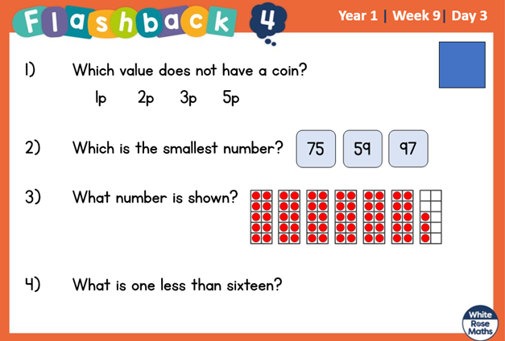

Slide 3
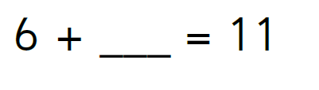

Slide 4
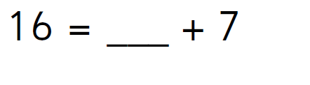
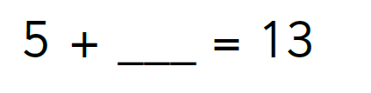

Slide 5
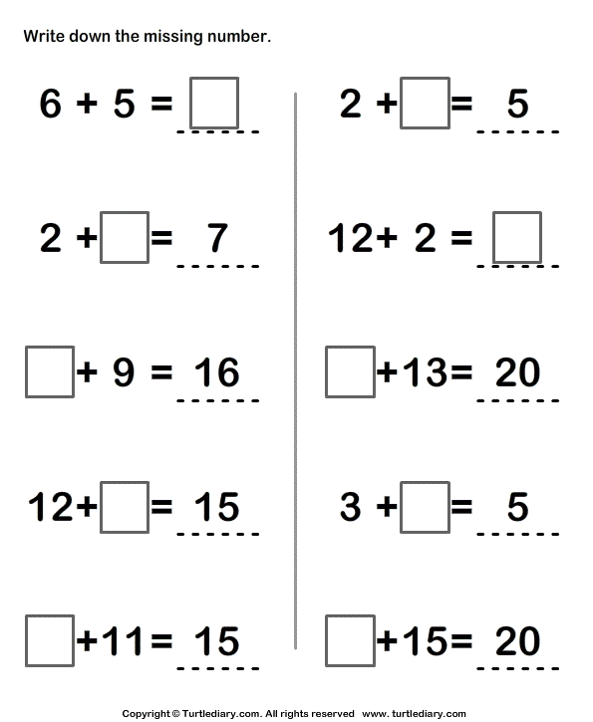

Slide 6
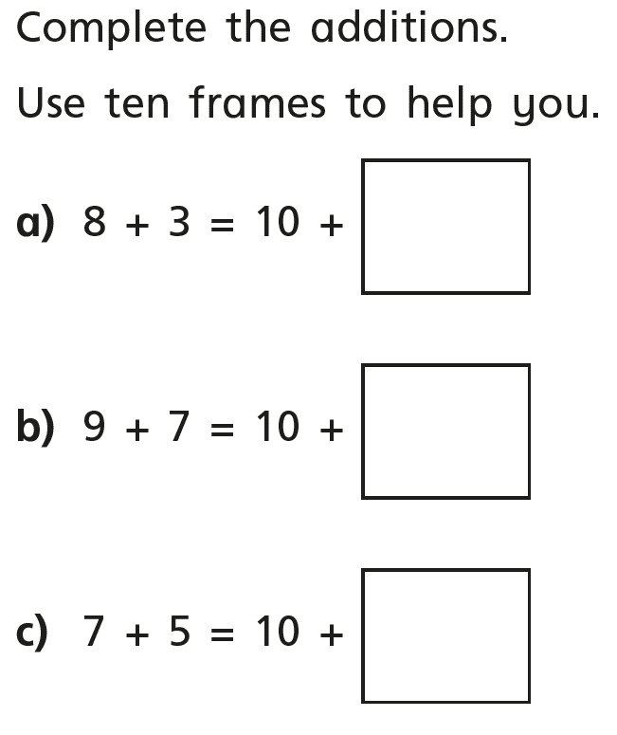
Challenge

Slide 7
https://www.topmarks.co.uk/maths-games/robot-more-or-less
Have a go with the addition online game. Drag the robots to the correct answer.

