Slide 1
The Dragon Machine by Helen Ward

Slide 2
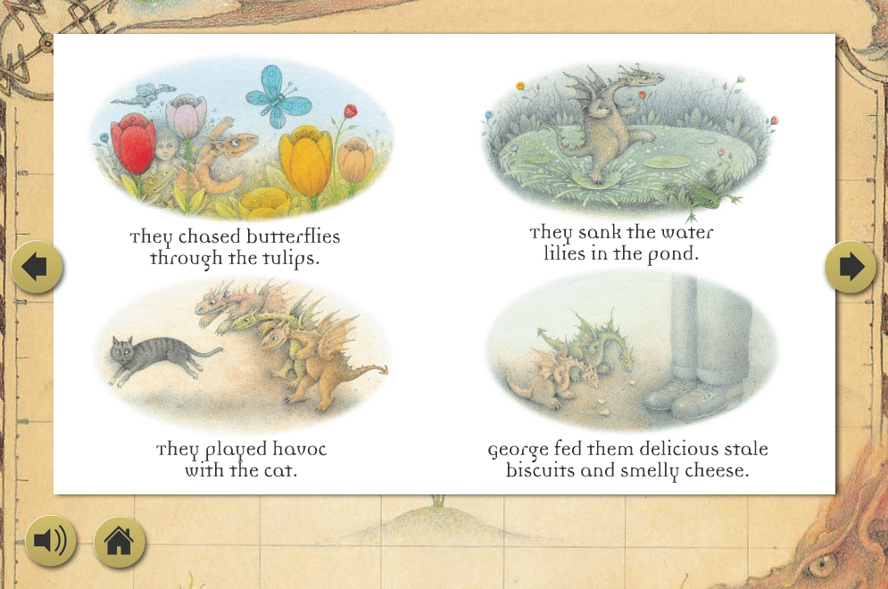

Slide 3

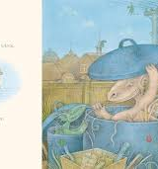
Can we use other verbs?
They ……..
jumped ate pushed
watched threw ran

Slide 4

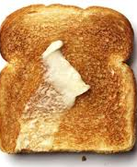
George fed them …….

Slide 5
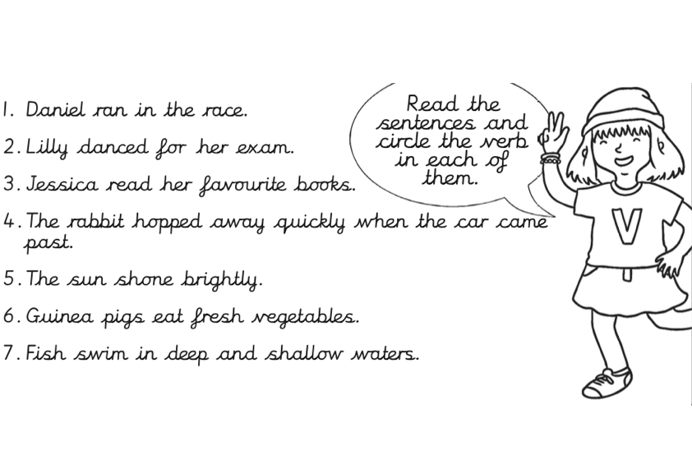
Extension task:

