Slide 1
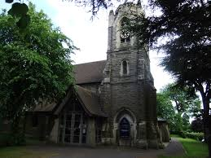
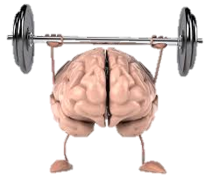
Write down as many different things that the Church might do.
E.g. local school celebration performances!
What does the Church do?
Challenge: What impact do you think a Church can have on a local community? Give examples to support your answer.

