Slide 1

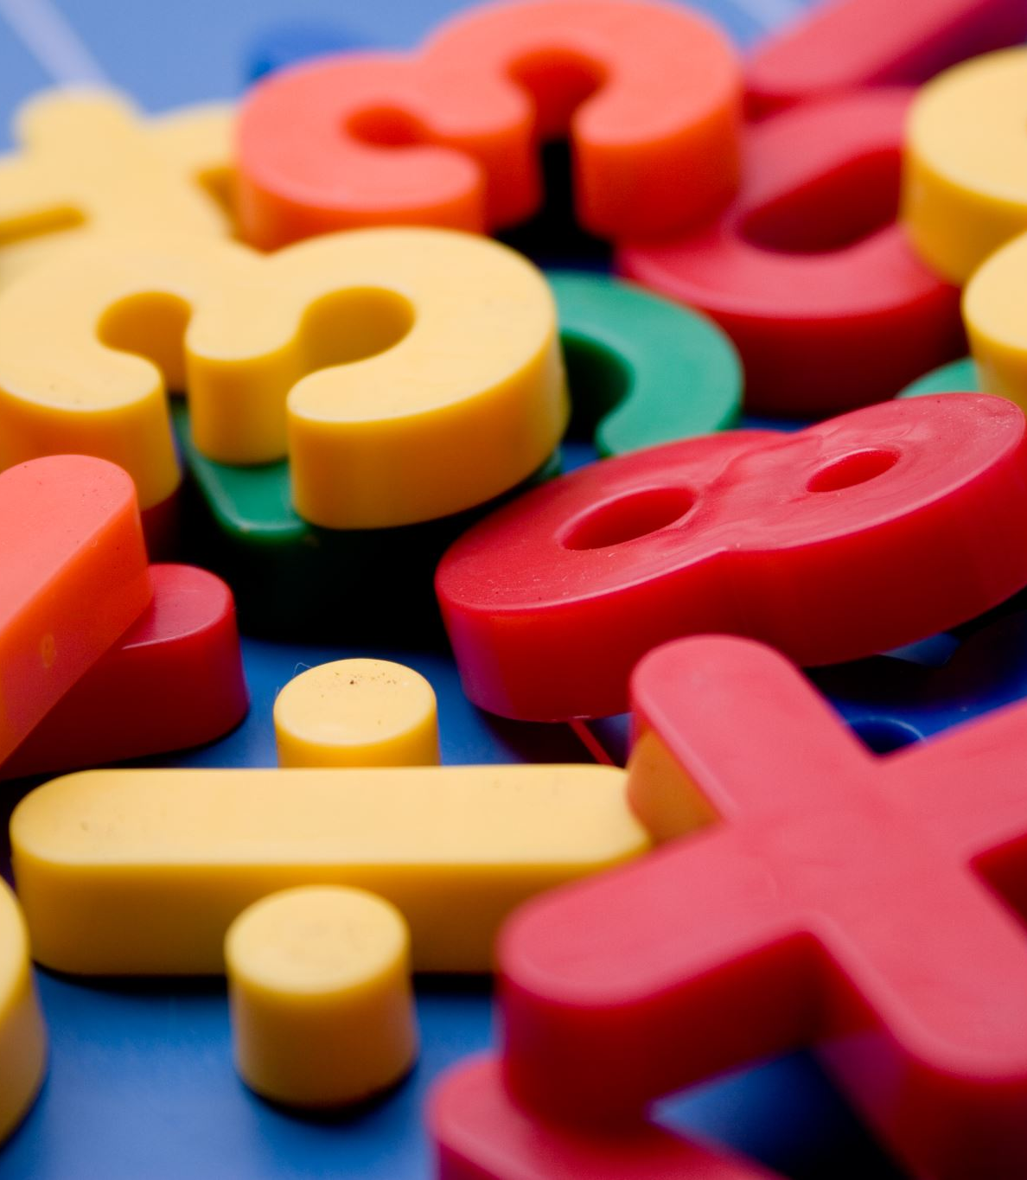
Subtraction
L.O. Solve word problems.

Slide 2
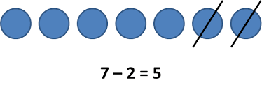
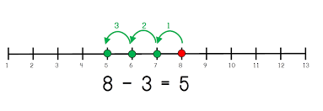
How can we ‘take away’ ?

Slide 3
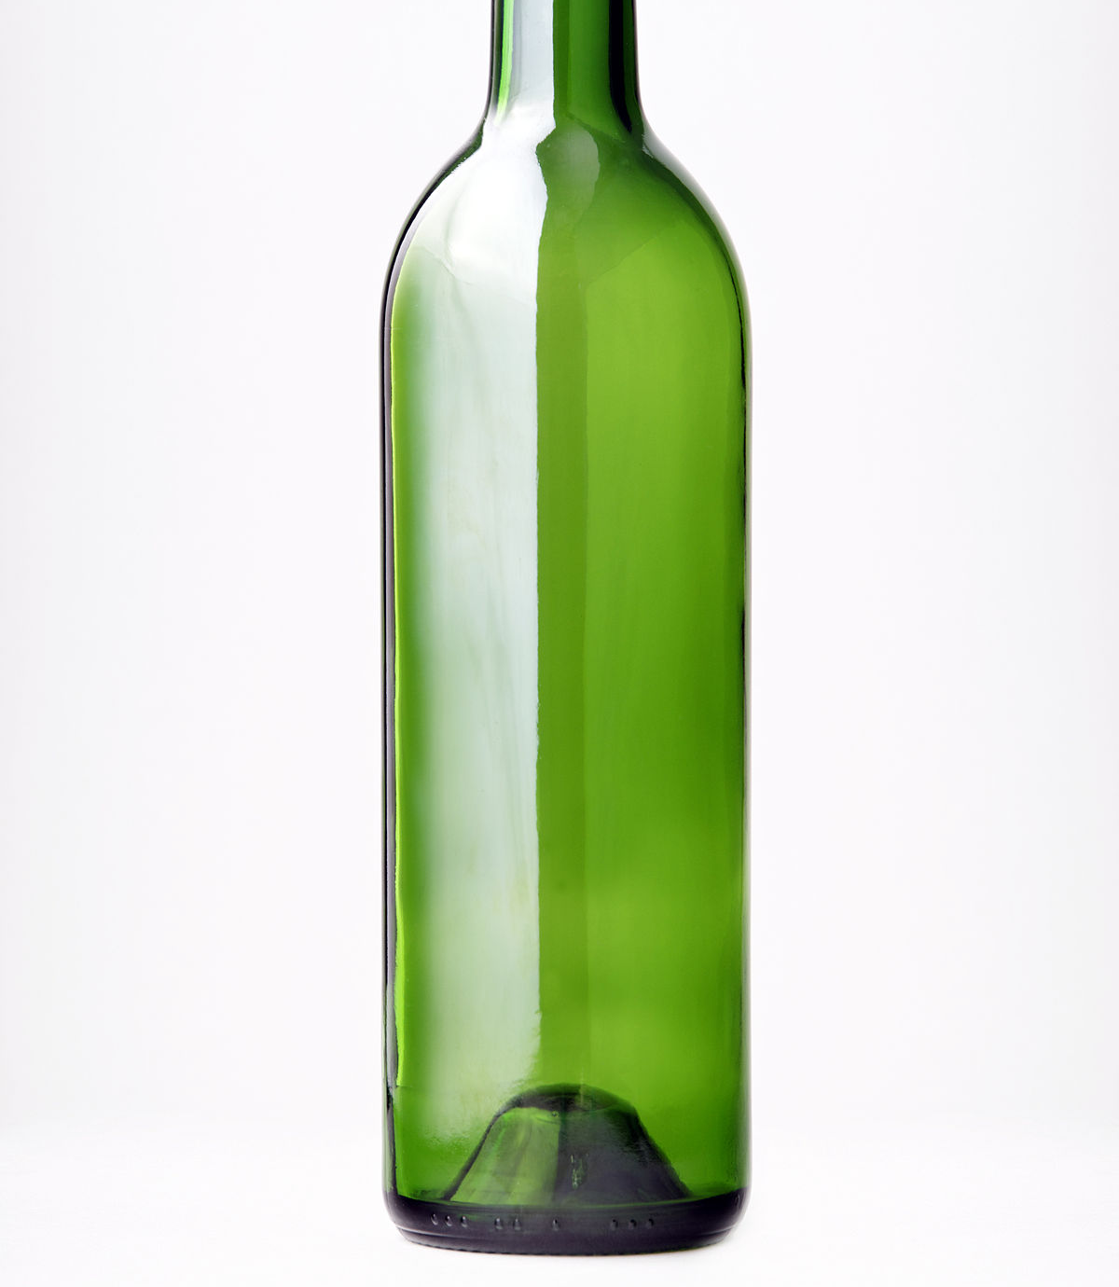
If you had 10 bottles and 3 of them smashed, how many of them would you have left?

Slide 4
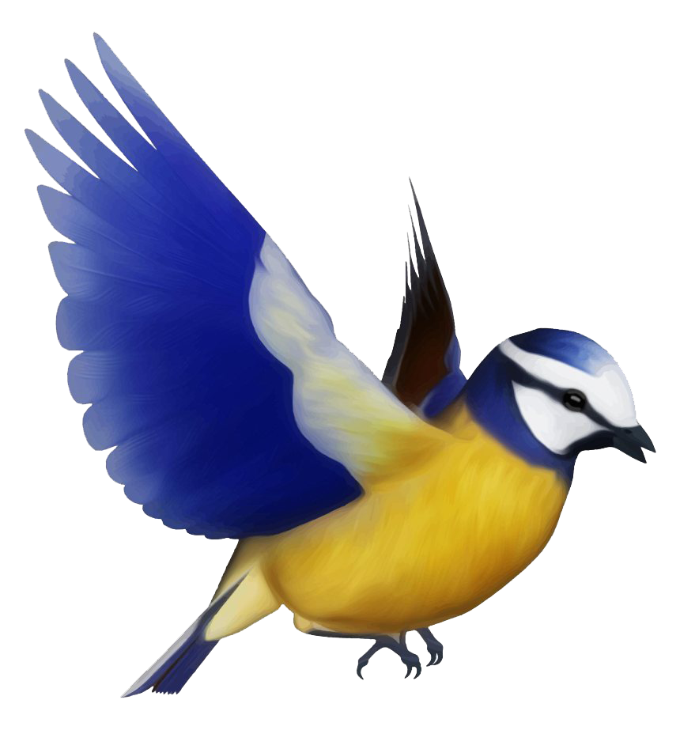
If you had 8 birds in your garden and 2 of them flew away, how many birds would you have left?

Slide 5
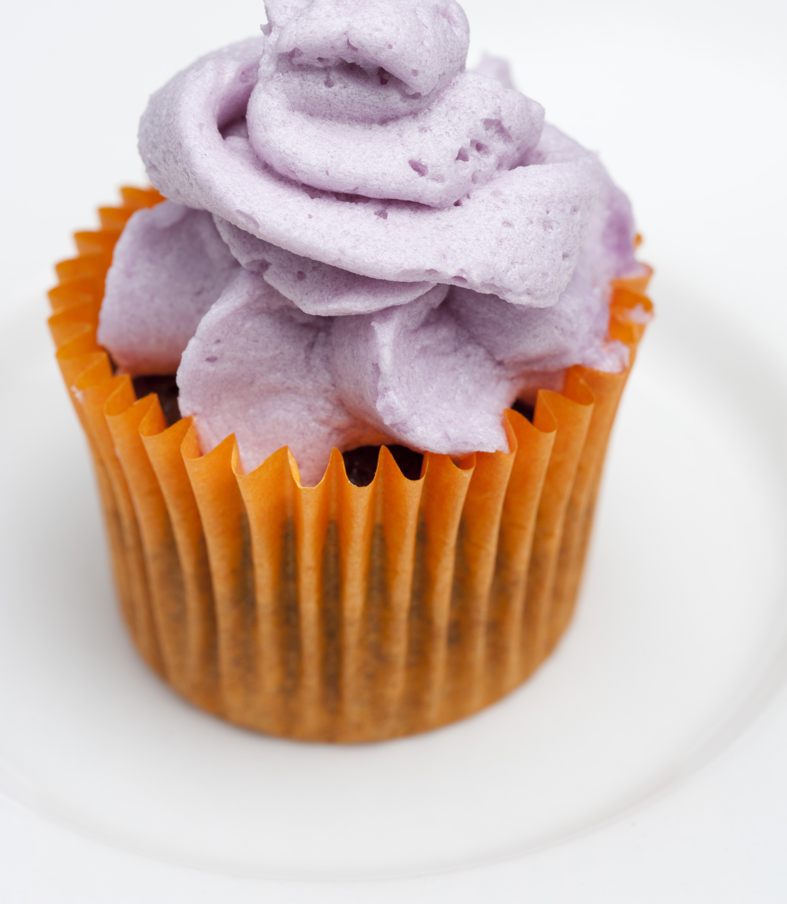
If you had 9 cakes and you ate 4 of them, how many would you have left?

Slide 6
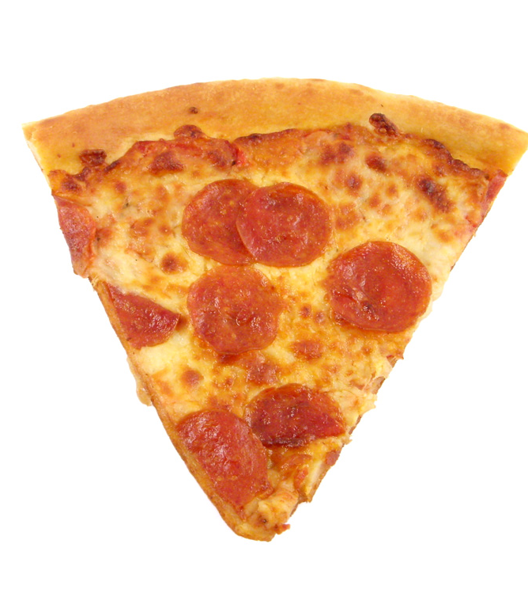
If you had 13 slices of pizza and 6 slices are eaten, how many slices would you have left?

Slide 7

If you had 15 flowers and you give 5 away, how many flowers would you have left?

Slide 8

Tom catches 11 mice. 4 of the mice escape. How many does Tom have now?

Slide 9
Challenge task ……..
14
7 | ?

Slide 10
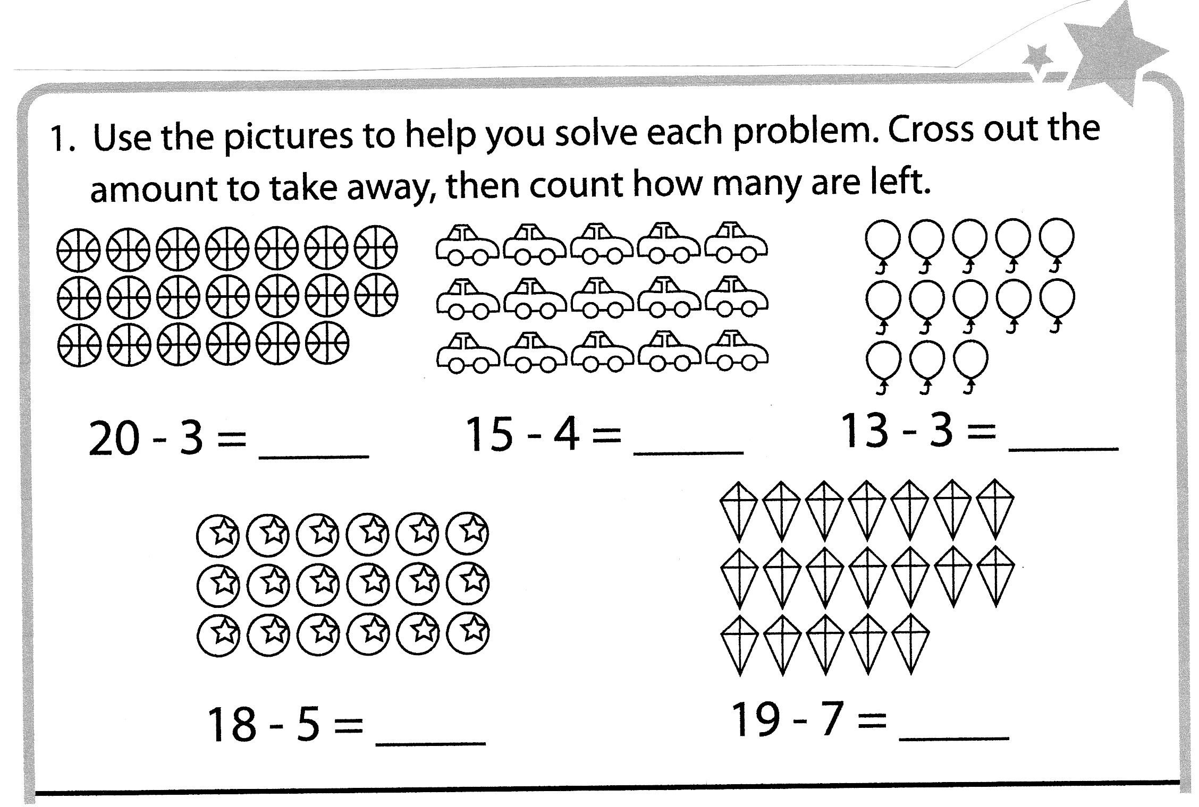
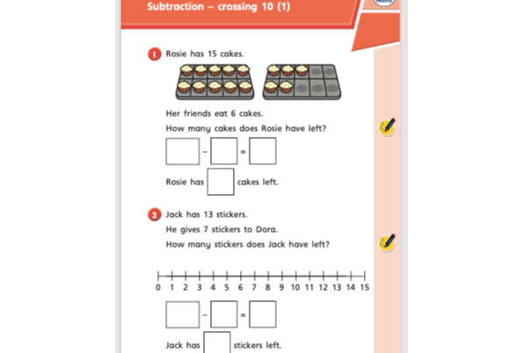
On the school web site there are two follow up activities.
EXTRA CHALLENGE
Use number bonds to 20 to write subtraction facts.
Eg. 20 – 7 = 13
20 – 9 = 11

