Slide 1
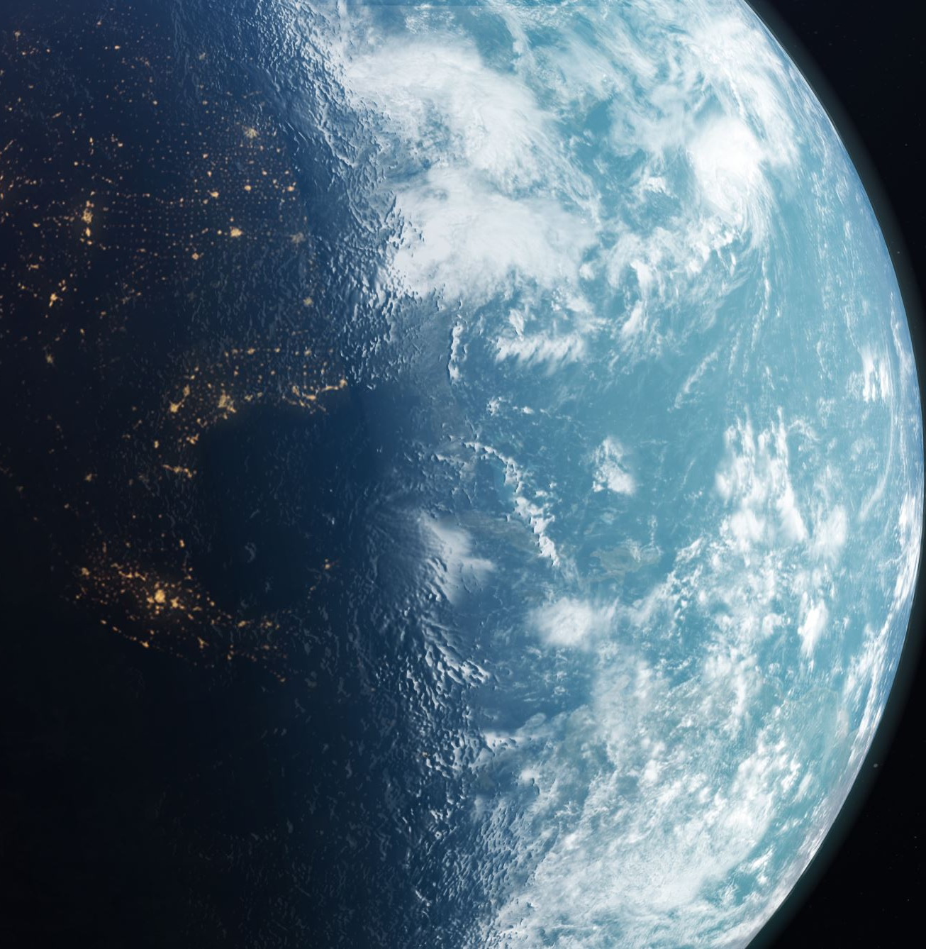
World Climates
Can we identify different climates around the world?
Climate is like the weather but over a long time.

Slide 2
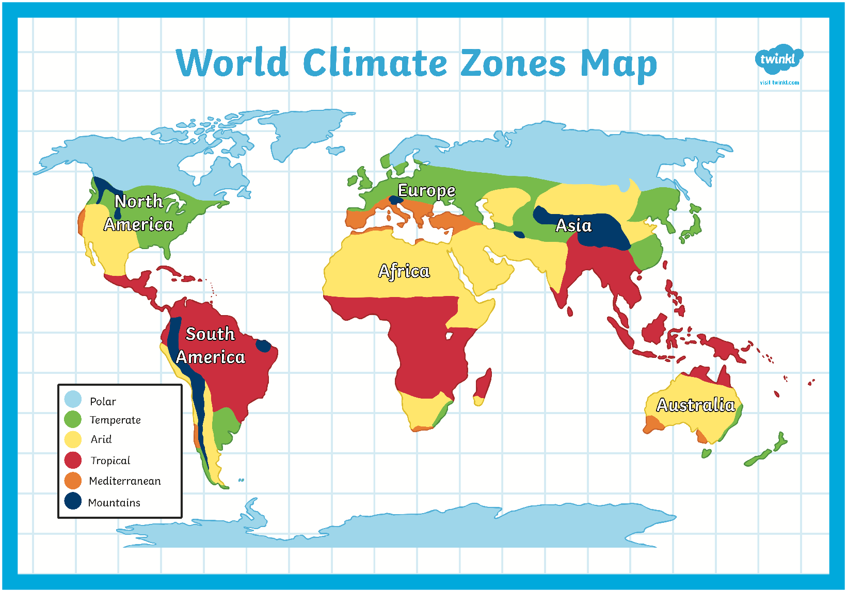
Antarctica

Slide 3
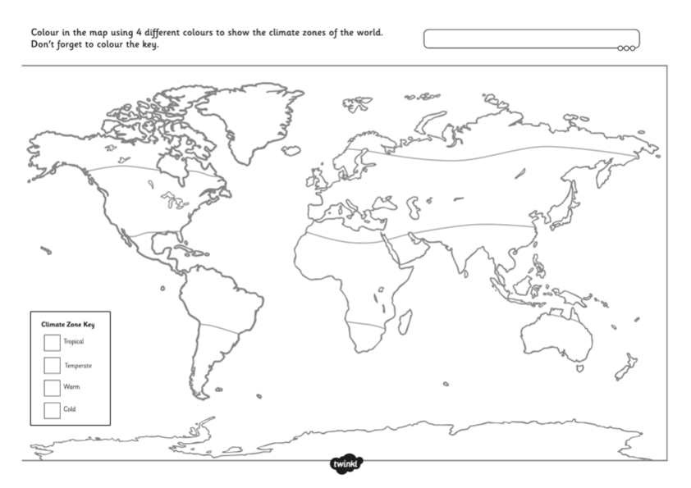

Slide 4
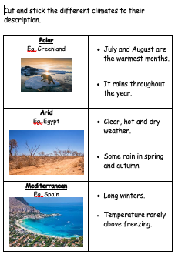
Follow up activity
Can you match the climate to its description?
Eg.
Temperate.
Eg. UK * July and August are the
warmest months.
* It rains throughout the year.

