Slide 1
The ZONES of Regulation®
Thursday 4th February 2021

Slide 2
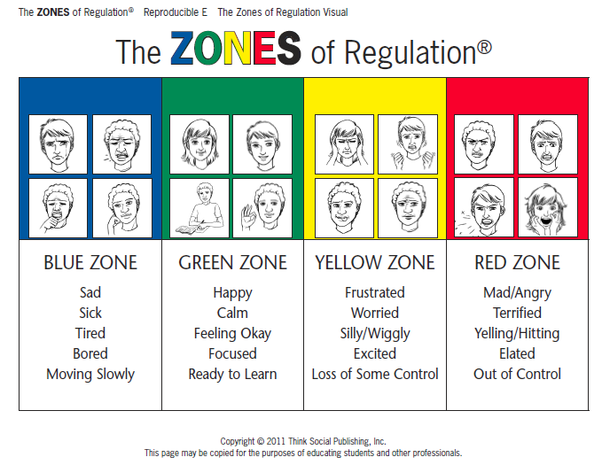

Slide 3
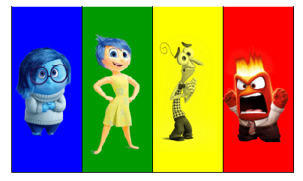
Other Tools and ZONES Visuals
https://www.youtube.com/watch?v=puXSw8yrVnI

Slide 4
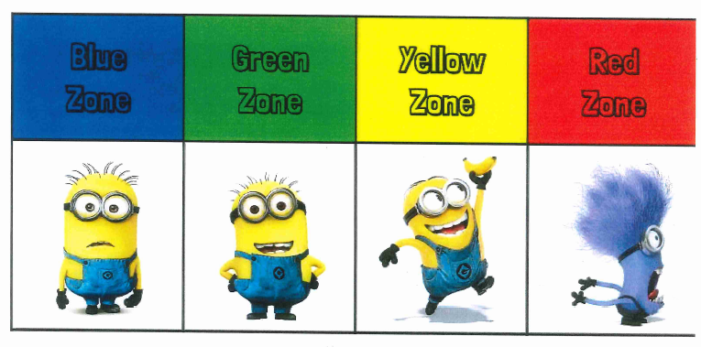
Other Tools and ZONES Visuals
Sad Happy Frustrated Mad/angry
Sick Calm Worried Terrified
Tired Feeling ok Silly/wiggly Yelling/hitting
Bored Focused Excited Elated
Moving slowly Ready to learn Loss of some control Out of control

Slide 5
There is no such thing as a bad ZONE.
It is important to note that everyone experiences all of the zones—the Red and Yellow Zones are not the “bad” or “naughty” zones.
All of the zones are expected at one time or another.

Slide 6
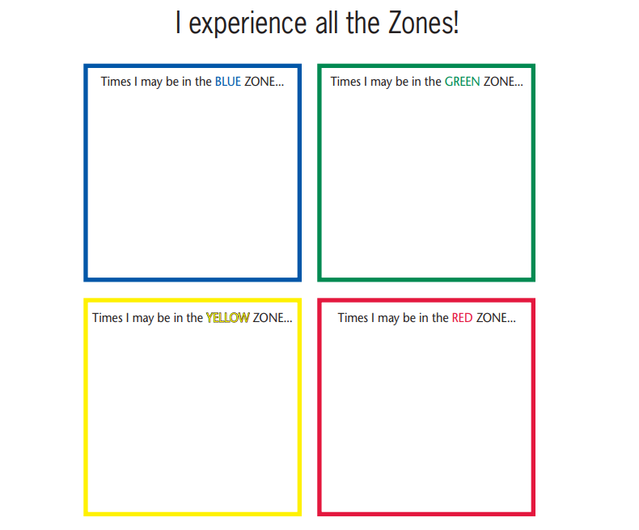
Draw a picture of when you might be in each zone.

Slide 7
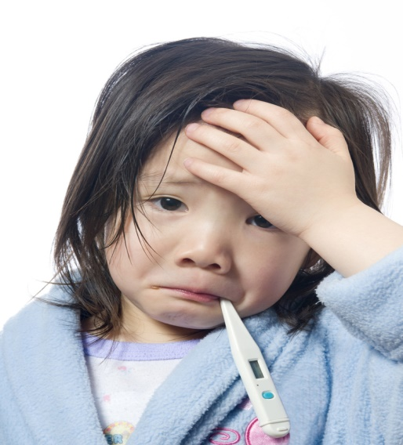
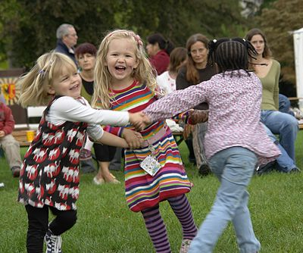

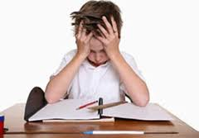
Draw a picture of when you might be in each zone.

Slide 8
ZONES Lesson Videos to show emotions and zones:
  Here is a video on what it looks like to be in the Blue Zone (Barbie crying and upset): http://www.youtube.com/watch?v=a5ze5PfDEzI&index=2&list=PL87B22B04EC463D3B
  Here is a video on what it looks like to be in the Green Zone: (Finding Nemo: Just Keep Swimming): https://www.youtube.com/watch?v=sB6W2VAx2J8
  Here is a video on what it looks like to be in the Yellow Zone (Mike’s New Car): https://www.youtube.com/watch?v=zfC_GuHiP68
  Here is a video on what it looks like to be in the Red Zone (Lucy mad in Charlie Brown): http://www.youtube.com/watch?v=pq9hBEvFNlM&list=PLD7C6A74DFECE6B3F&index=1

Slide 9
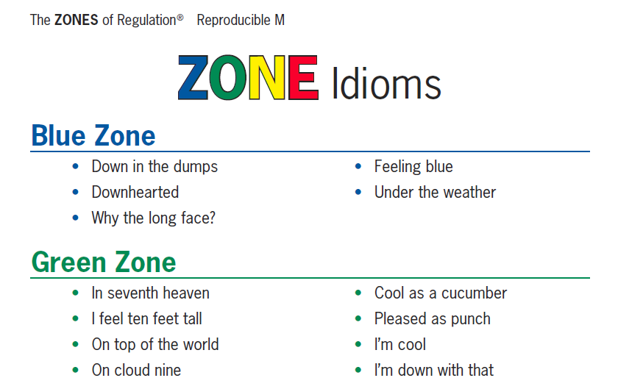
Other Tools and ZONES Visuals

Slide 10
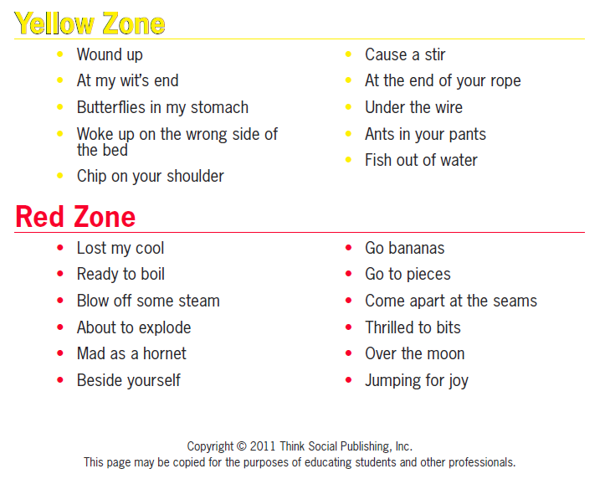
Other Tools and ZONES Visuals

Slide 11
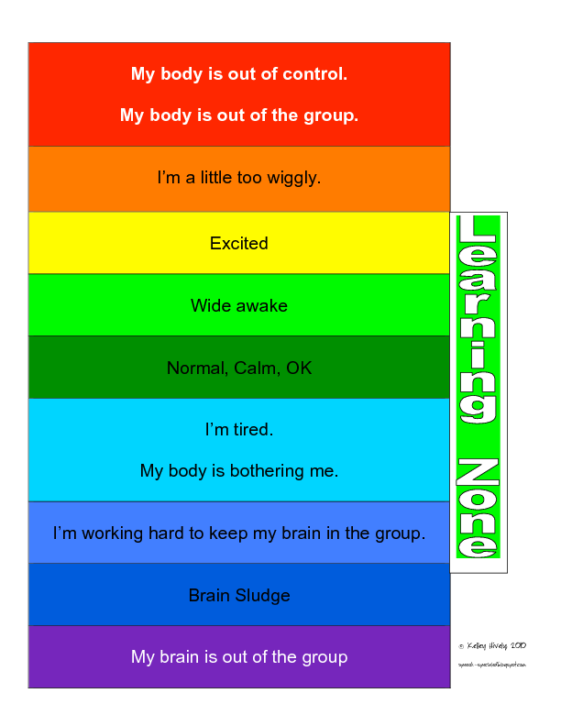

Slide 12
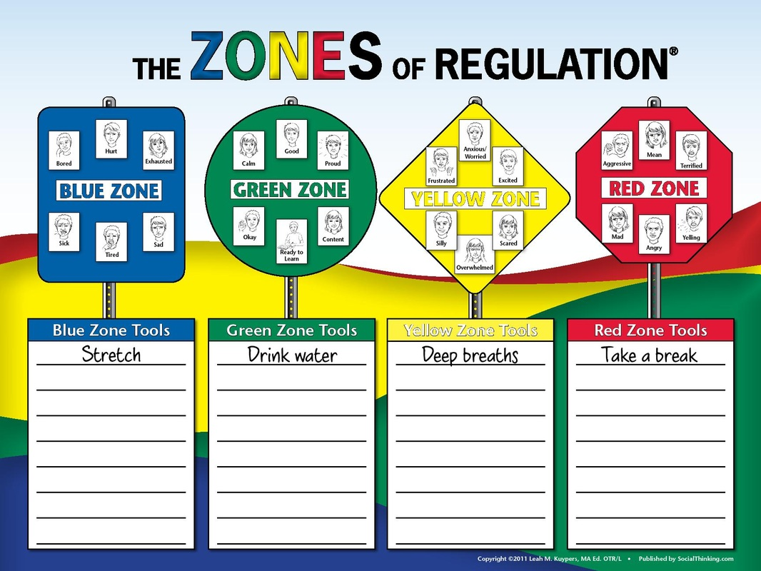

Slide 13
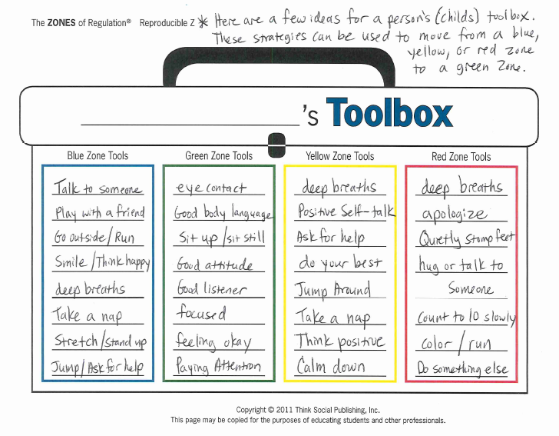

Slide 14
Follow up activity:
Zone of Regulation Box – use a shoe box or something similar from the recycling.
Sometimes we find it hard to control our emotions. This box is to help you to deal with these difficult feelings and not hurt/shout at others or be too hard on yourself.
This box will make you feel better.
What things make you feel better?
Favourite book
Favourite teddy/toy
Favourite blanket
Favourite picture
Can you think of anything else?

Slide 15
What you put in the box is completely up to you.
You could include:
Fidget spinners
Squishes
Stress balls
Feathers/soft material
Cotton wool
Blu-tack
Playdough
Earphones and favourite music
Mindfulness colouring book
Snack or drink
Special teddy/toy
Notepad and pen
Decorate your box and keep it somewhere safe such as under your bed.

Slide 16
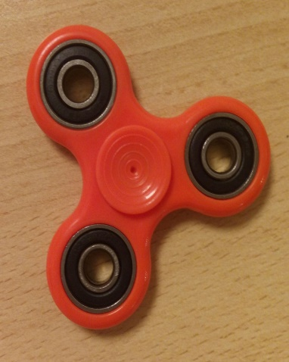
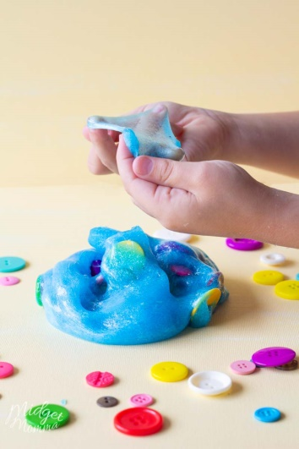
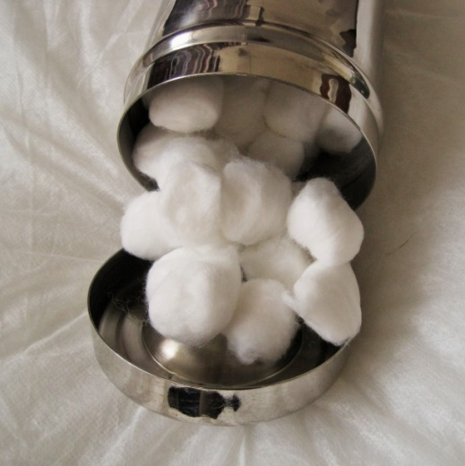
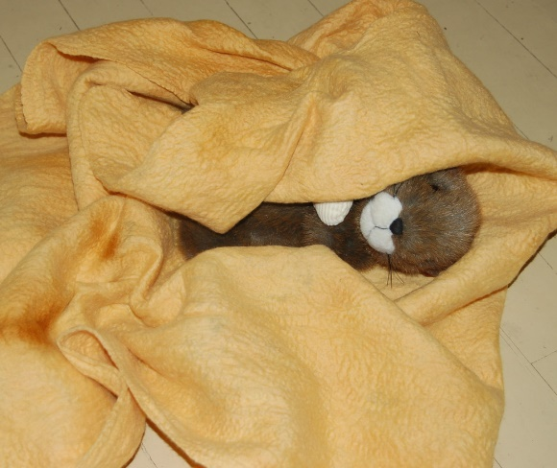

Inside your box

Slide 17
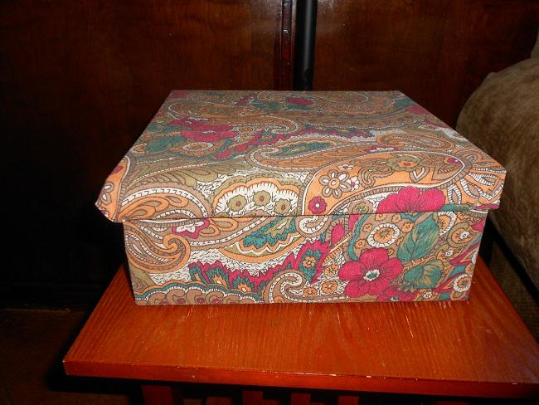
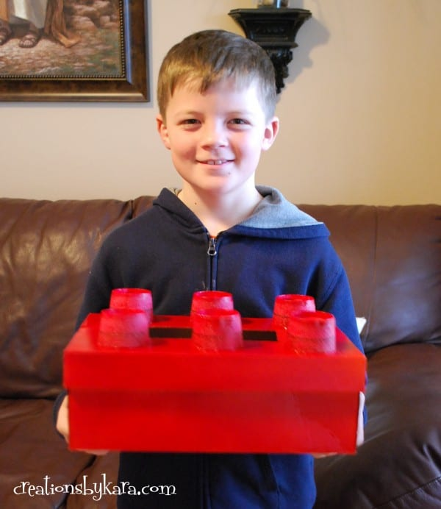
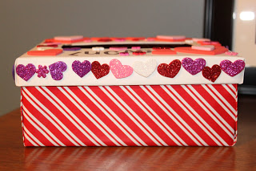
Decorate the outside of your box

Slide 18
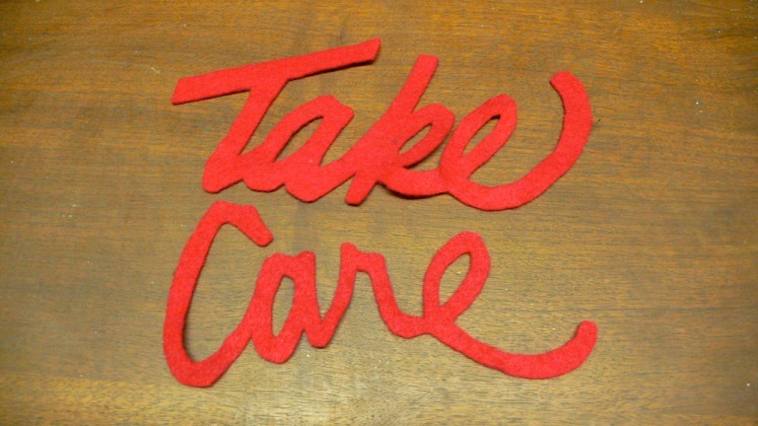
Have fun making your Zone of Regulation box and we look forward to seeing some pictures of them.
Take care of yourself and each other. See you all soon!

