Slide 1
Thursday’s Phonics Session

Slide 2
Find an item at home starting with the letter…
Mm
Ll
Bb
Tt

Slide 3

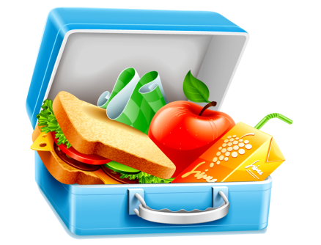


Now write down the item you found starting with these letters…
Mm - mirror
Ll - lunchbox
Bb - book
Tt - tray

Slide 4
Sentence…
Can you use at least one of those words in a sentence?

Slide 5
Sentence…
I looked in the mirror to check my hair before collecting my lunchbox and walking to school. When I arrived, I placed my reading book into my tray underneath the desk.
mirror
lunchbox
book
tray

Slide 6
Now write down as many words as you can that contain the phoneme/grapheme ee…
ee
For example: feet

Slide 7
Now write down as many words as you can that contain ee…
ee
feet, sheet, tweet, between, sheen, sheer, teenager, weed, need and so on.
Rowan children – If you want to log out and make your own sentences using the ee phoneme/grapheme do so now.

Slide 8
Today we are looking at the split digraph…
e_e

Slide 9
Fill in the missing e_e words.

Slide 10
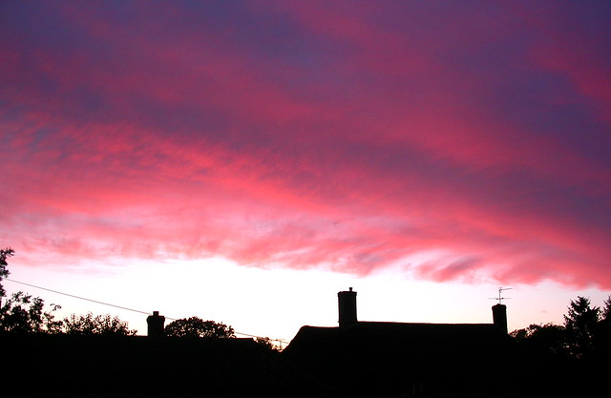
Emma likes to sit in her garden on a warm, summer’s ______________

Slide 11
Emma likes to sit in her garden on a warm, summer’s
evening.

Slide 12
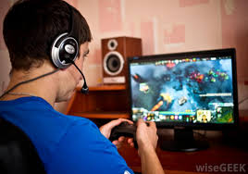

Jamie really wanted to ________the next level on his game.

Slide 13
Jamie really wanted
to complete the next
level on his game.

Slide 14

I’ve made a mistake! Please can you help me to _______it?

Slide 15
I’ve made a mistake! Please can you help me to delete it?

Slide 16
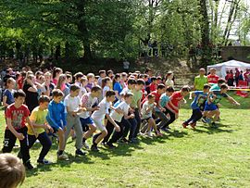
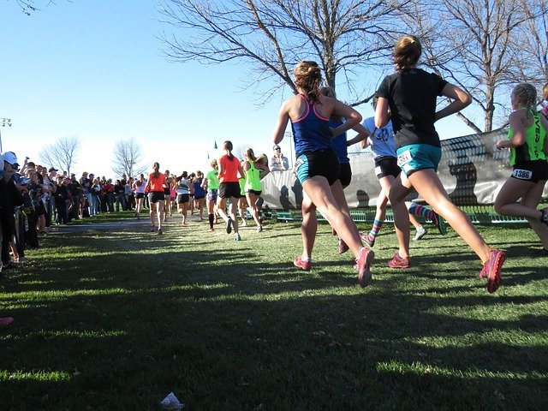
Whose running shoes are _________? Asked Mrs Boughton.

Slide 17
Whose running shoes are these? Asked Mrs
Boughton.

Slide 18
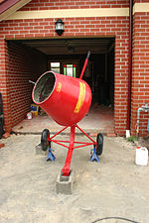
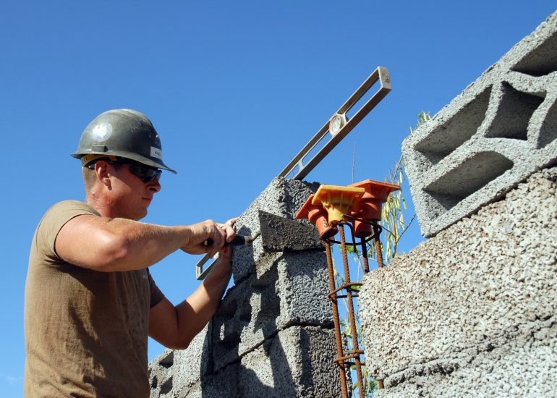
In order to create a steady wall a builder named ______ had to
mix the ________.

Slide 19

In order to create a steady wall a builder named Steve had to
mix the concrete.

Slide 20
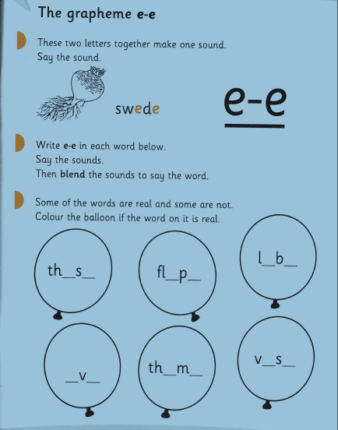
e_e split digraph activity
Can you identify the real e_e words and the nonsense ones?

Slide 21

Thank you everybody!
It was lovely to see you all!
See you tomorrow at 10.00am

