Slide 1
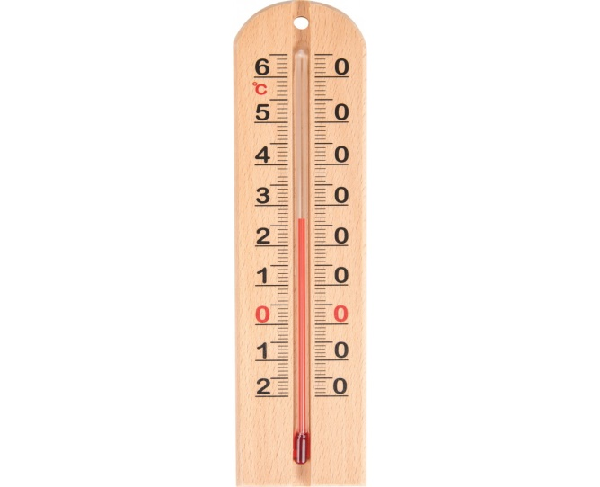
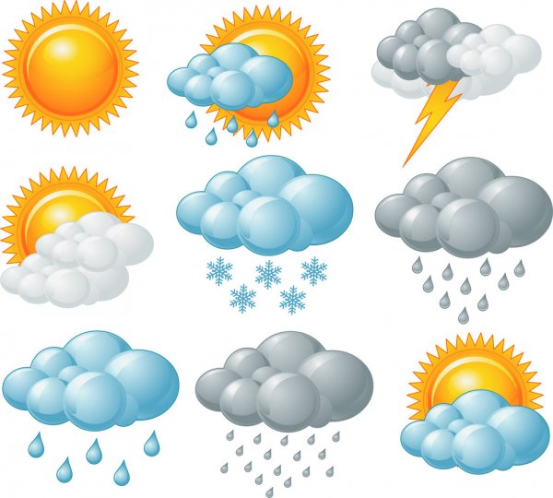
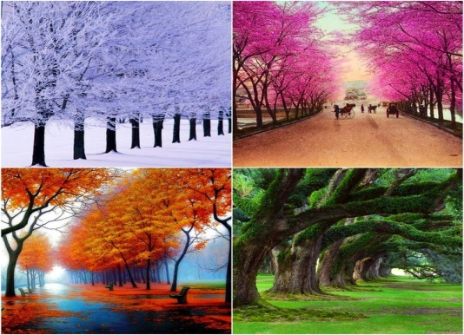
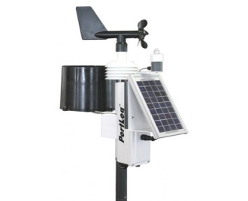
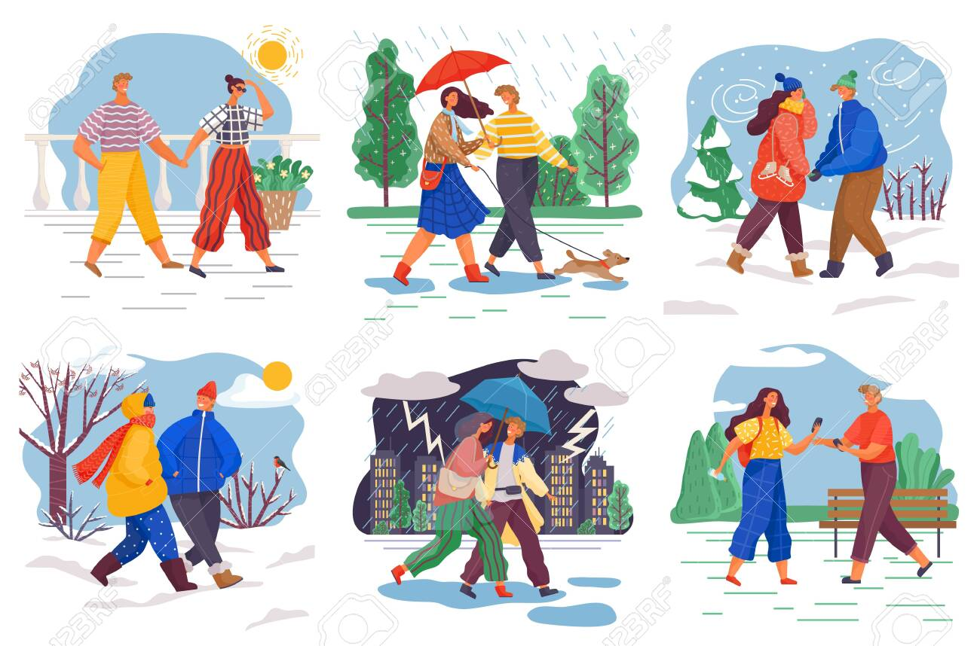
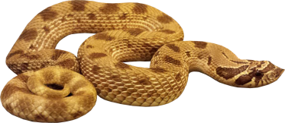
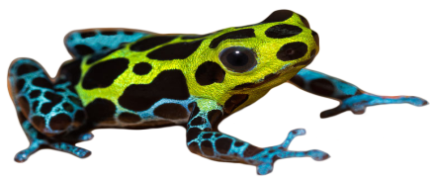
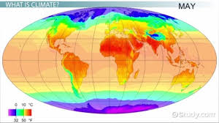
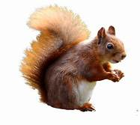
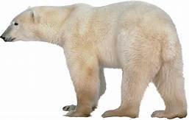
Key Vocabulary:
Hot
warm
cold
climate
seasons
weather
temperature
equator
KS1 Spring 2021.
Knowledge Organiser
Science and Geography.
Winter
Spring
rain
sleet
sunshine
dry
frost
Autumn
Summer
misty
freezing
cloudy
snow
thunder and lightening

Slide 2
LO: To understand the differences between the four seasons.
Lesson one
You will need:
Pencil
Paper
Cloze Procedure activity/complete a seasons quiz on Purple Mash.

Slide 3
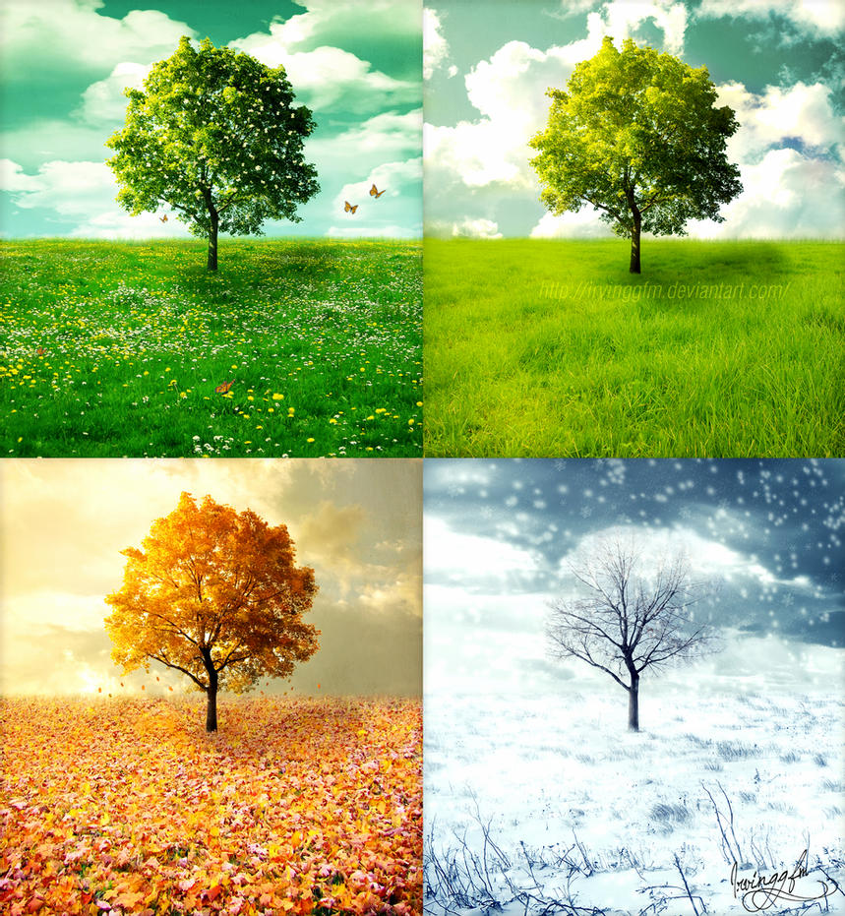
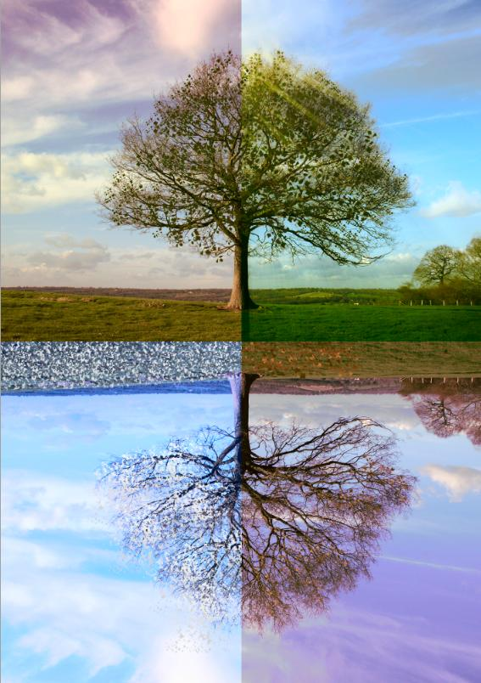
Spring
Summer
Autumn
Winter

Slide 4
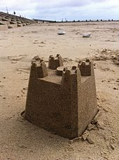
Summer
Summer begins in the month of ______________ and lasts until September.
During Summer, the weather gets_____________ and the sun usually shines. People often go paddling in the sea and children enjoy building ____________________.
Possible words:
December
warmer
snowmen
June
colder
sandcastles
lego

Slide 5
Summer
Summer begins in the month of June and lasts until September.
During Summer, the weather gets warmer and the sun usually shines. People often go paddling in the sea and children enjoy building sandcastles.
Possible words:
December
warmer
snowmen
June
colder
sandcastles
lego

Slide 6
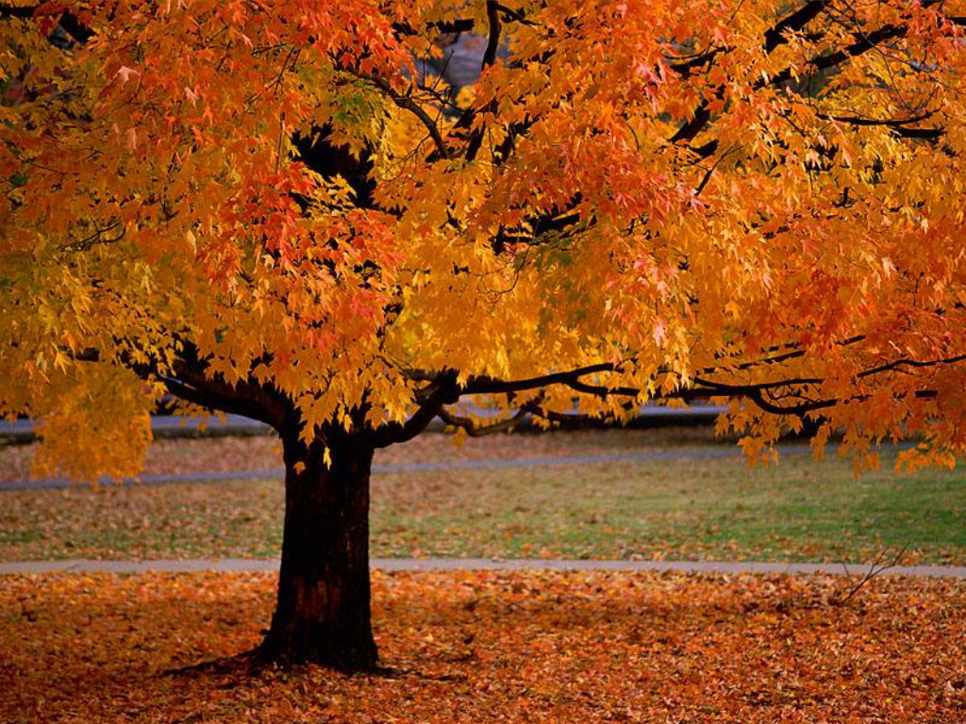
Autumn
Autumn begins in the month of___________________ . The leaves turn brown, red, yellow and orange and eventually they fall off the trees.
The weather can become ___________ and wetter. Some animals prepare for the Winter by going into a long sleep called ____________________.
Possible words:
September
hibernation
warmer
drier
cooler
May
snoozing

Slide 7
Autumn
Autumn begins in the month of September. The leaves turn brown, red, yellow and orange and eventually they fall off the trees.
The weather can become cooler and wetter. Some animals prepare for the Winter by going into a long sleep called hibernation.
Possible words:
September
hibernation
warmer
drier
cooler
May
snoozing

Slide 8
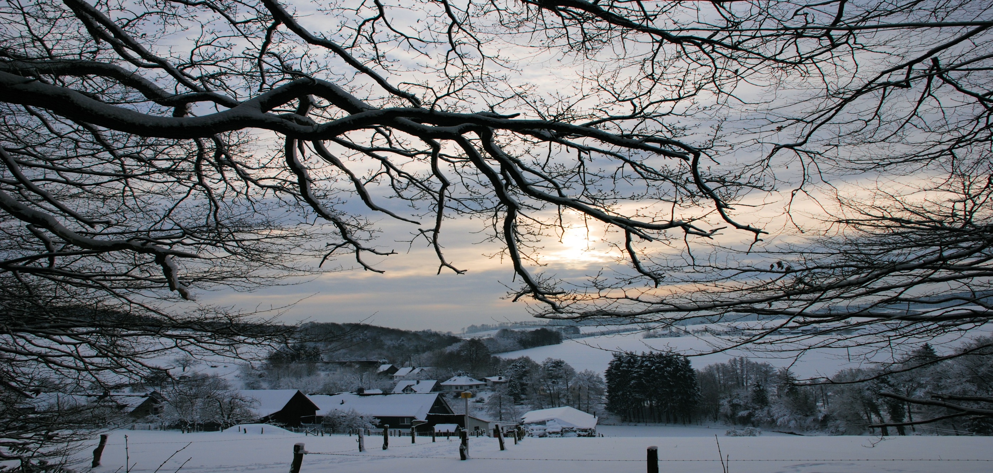
Winter
Winter begins in the month of December. The temperature is often the coldest of all the seasons. People can wake up to frost, ice and snow. Children often enjoy sledging and building snowmen.
Possible words:
December
snowmen
frost
hottest
drier
sledging
August
snoozing
coldest
Winter begins in the month of _________. The temperature is often the ________of all the seasons. People can wake up to _______, ice and snow. Children often enjoy __________and building _________.
Possible words:
December
snowmen
frost
hottest
drier
sledging
August
snoozing
coldest

Slide 9
Winter
Winter begins in the month of December. The temperature is often the coldest of all the seasons. People can wake up to frost, ice and snow. Children often enjoy sledging and building snowmen.
Possible words:
December
snowmen
frost
hottest
drier
sledging
August
snoozing
coldest
Winter begins in the month of December. The temperature is often the coldest of all the seasons. People can wake up to frost, ice and snow. Children often enjoy sledging and building snowmen.
Possible words:
December
snowmen
frost
hottest
drier
sledging
August
snoozing
coldest

Slide 10
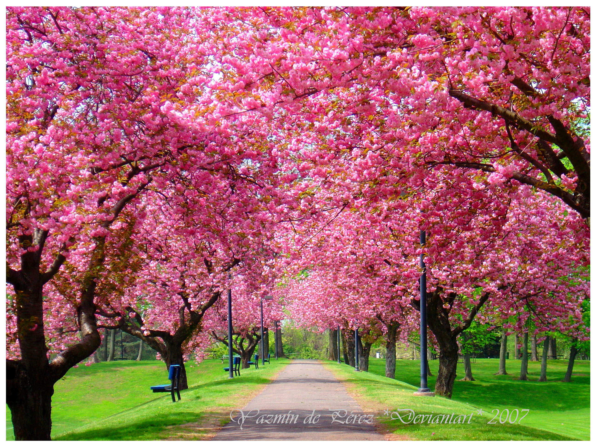
Spring
Spring begins in the month of _______. The season can sometimes be ______with lots of _____. Plants begin to grow and flowers and ________ start to appear. Many animals start to have babies and it is a time for celebrating Easter.
Possible words:
March
Christmas
colder
Easter
wet
blossom
October
honey
babies
Spring begins in the month of _______. The season can sometimes be ______with lots of _____. Plants begin to grow and flowers and ________ start to appear. Many animals start to have ________ and it is a time for celebrating ________.
Possible words:
March
Christmas
colder
rain
Easter
wet
blossom
October
honey
babies

Slide 11
Spring
Spring begins in the month of _______. The season can sometimes be ______with lots of _____. Plants begin to grow and flowers and ________ start to appear. Many animals start to have babies and it is a time for celebrating Easter.
Possible words:
March
Christmas
colder
Easter
wet
blossom
October
honey
babies
Spring begins in the month of March. The season can sometimes be wet with lots of rain. Plants begin to grow and flowers and blossom start to appear. Many animals start to have babies and it is a time for celebrating Easter.
Possible words:
March
Christmas
colder
rain
Easter
wet
blossom
October
honey
babies

Slide 12
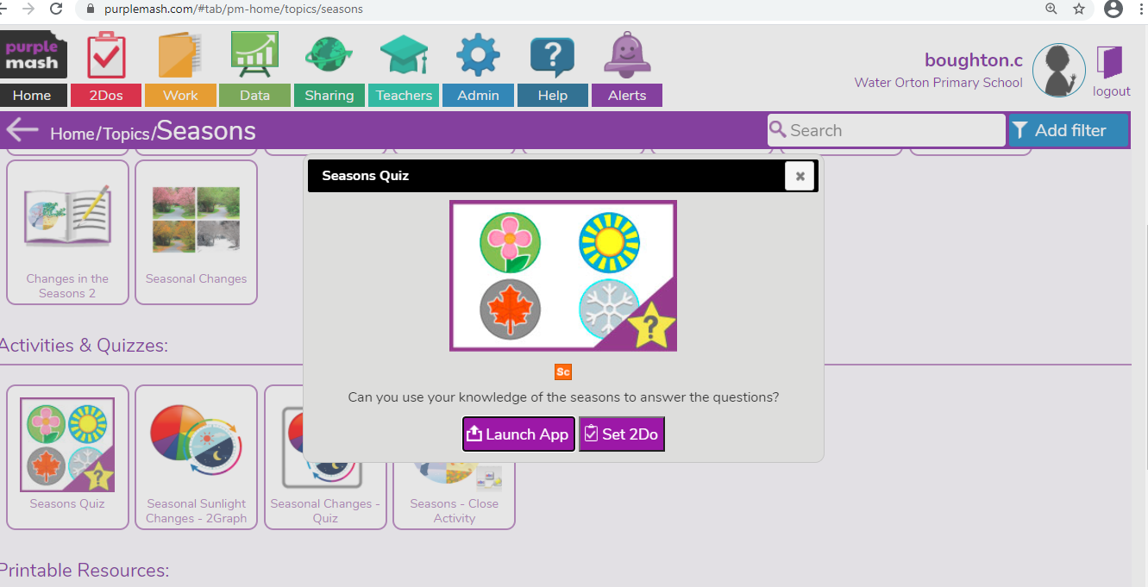
Quiz Time.

Slide 13
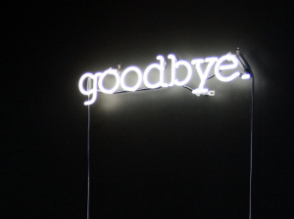
Thank you and see you again at 1.30pm .

