Slide 1
Wednesday 3rd March 2021
LO: To understand how long a minute is and complete activities within this time.

Slide 2
Let’s remind ourselves:
How many seconds are in 1 minute?

Slide 3
Let’s remind ourselves:
60 seconds

Slide 4
Let’s remind ourselves:
How many minutes are in 1 hour?

Slide 5
Let’s remind ourselves:
60 minutes

Slide 6
Let’s remind ourselves:
How many hours are in 1 day?

Slide 7
Let’s remind ourselves:
24 hours

Slide 8
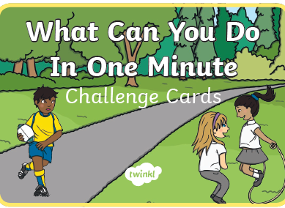

Slide 9
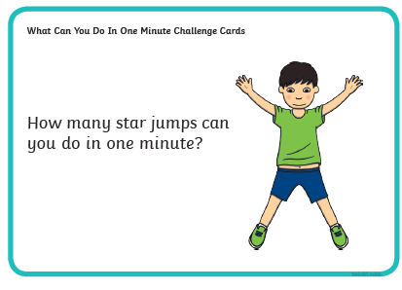
Estimate first:
How many did you actually do:

Slide 10
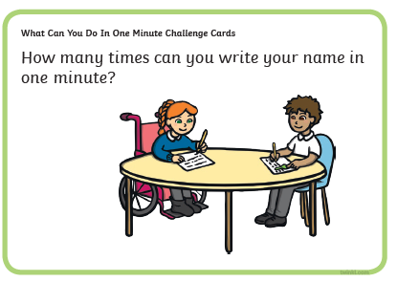
Estimate:
How many times:

Slide 11
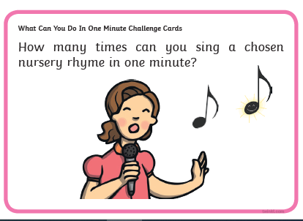
Estimate:
How many times:

Slide 12
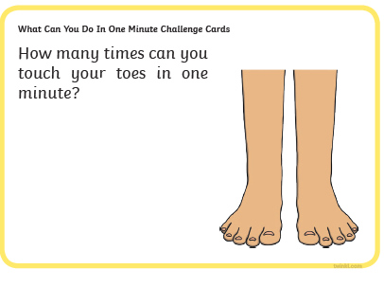
Estimate:
How many times:

Slide 13
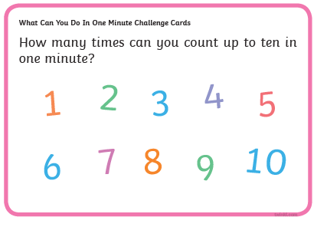
Estimate:
How many times:

Slide 14
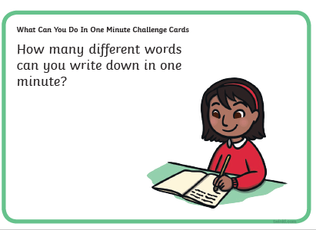
Estimate:
How many words:

Slide 15

What Can You Do In One Minute Challenge Cards
How many different ways can you find to tell the time in your house in one minute?
Estimate:
How many items:

Slide 16
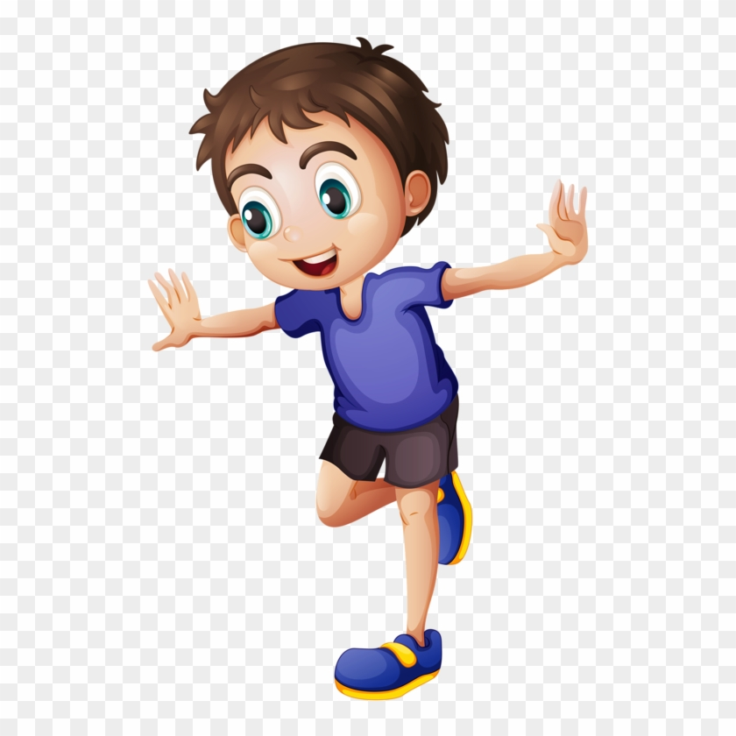
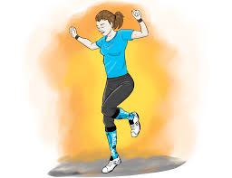
What Can You Do In One Minute Challenge Cards
How many times can you hop on one leg in one minute?
Estimate:
How many times:

Slide 17
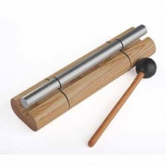

After all that hard work let’s lie down and relax. When you can hear the chime then close your eyes and when you hear the chime again then open them again.

Slide 18
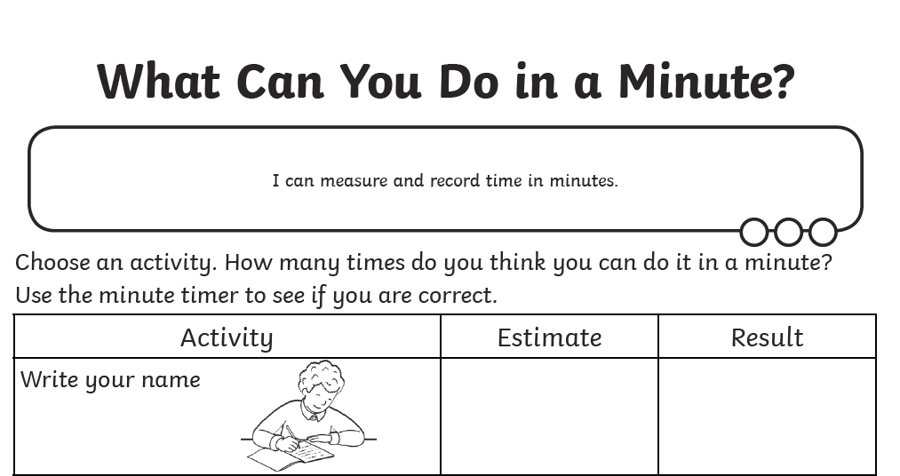
Thank you for taking part and I hope you enjoyed doing your minute challenges. Your follow up activity is to make up some of your own challenges for activities that you can complete in a minute.
If you are stuck for ideas then there is a sheet on the website and also it will be put on Teams under files after the lesson.
Have fun and see you tomorrow! ☺

