Slide 1
Thursday 11th February
Year 2
Common
Exception
Words

Slide 2
Common exception words for Year 2. Here are some common exception words – words that are spelled without using the normal spelling rules – that children in England are expected to be able to spell by the end of Year 2 (age 7).

Slide 3
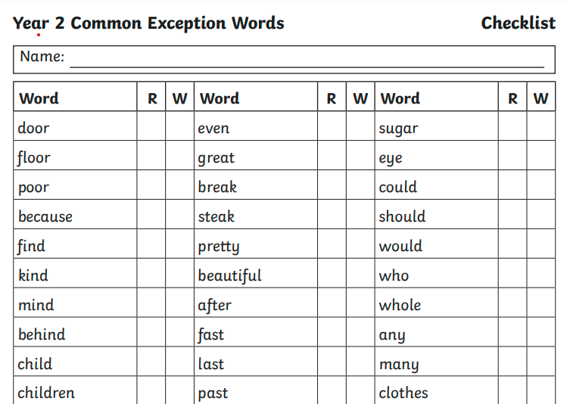

Slide 4
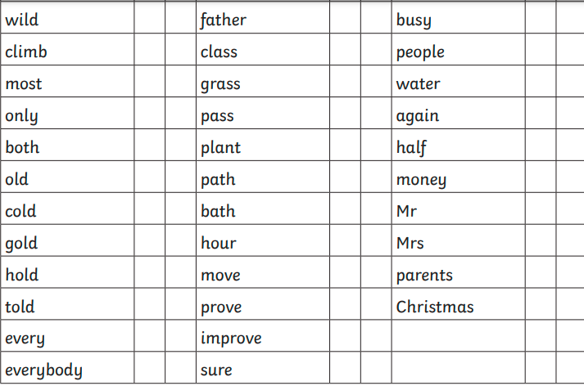

Slide 5
Let’s have a try and spelling 10 of these words.

Slide 6
Try your best and you can mark them with your adult helper.

Slide 7
any

Slide 8
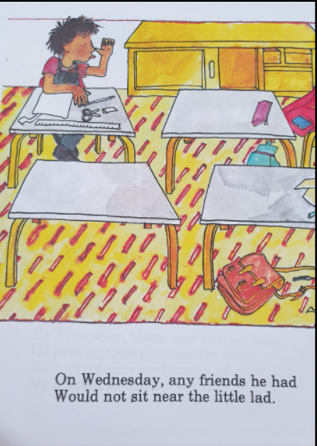

Slide 9
because

Slide 10
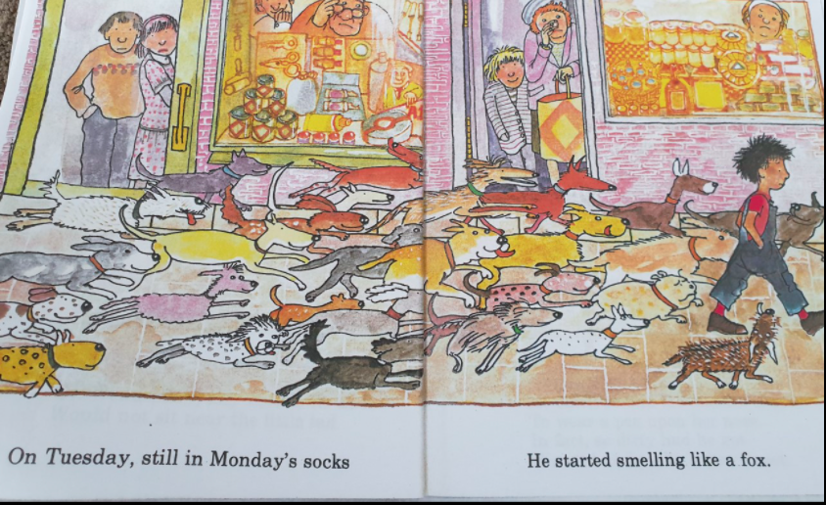
Can you write down or think of a sentence that includes because based on the picture and description of Georgie?

Slide 11
Georgie was chased by several dogs because he hadn’t changed his socks and was beginning to smell like a fox!

Slide 12
find

Slide 13
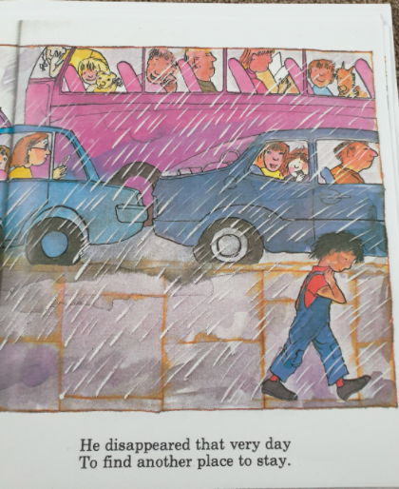

Slide 14
children

Slide 15
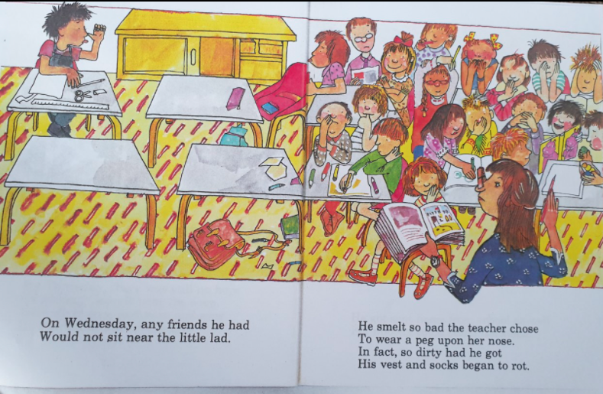
Can you write down or think of a sentence that includes children based on the picture and description of Georgie?

Slide 16
The children refused to sit near Georgie as his vest and socks were so dirty they began to rot!!

Slide 17
climb

Slide 18
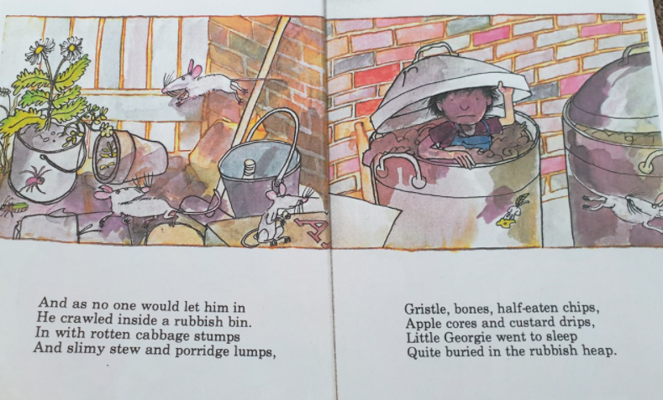
climb
Can you write down or think of a sentence that includes climb based on the picture and description of Georgie?

Slide 19
climb
As no one would let him in, Georgie decided to climb inside a rubbish bin full of rotten cabbage, slimy stew and porridge lumps.

Slide 20
wild

Slide 21
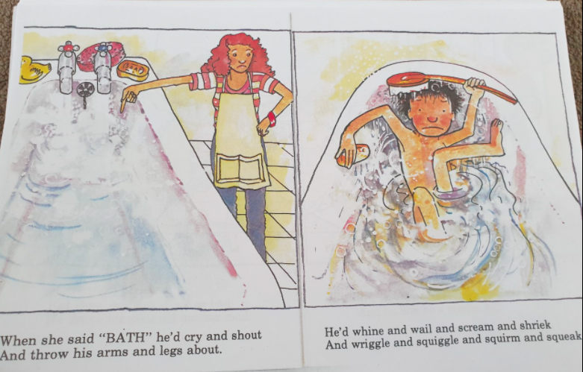
wild
What suggests that Georgie’s behaviour may be a bit wild?

Slide 22
beautiful

Slide 23
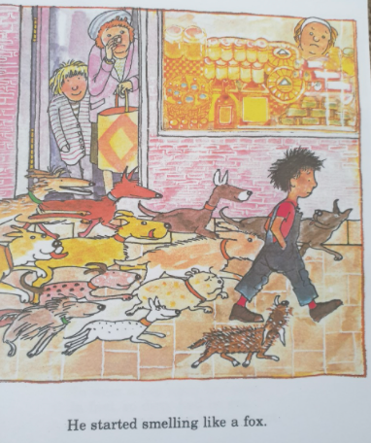
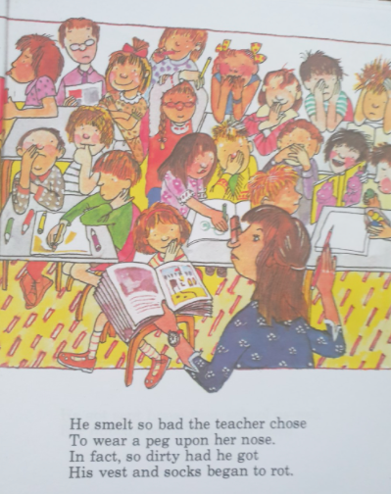
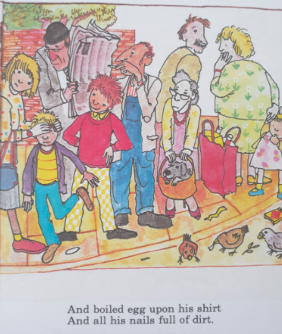
Georgie can’t be described as beautiful!
Write down as many words as you can to describe Georgie’s appearance.

Slide 24
everybody

Slide 25
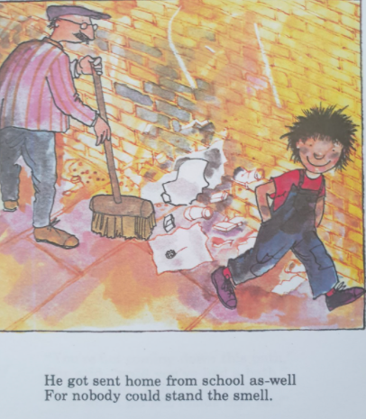
Which word is the opposite of everybody?

Slide 26
For nobody could stand the smell.

Slide 27
bath

Slide 28
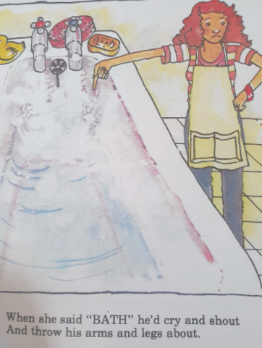
Georgie clearly doesn’t like having a bath!! How do you make your bath-time fun and relaxing?

Slide 29
class

Slide 30
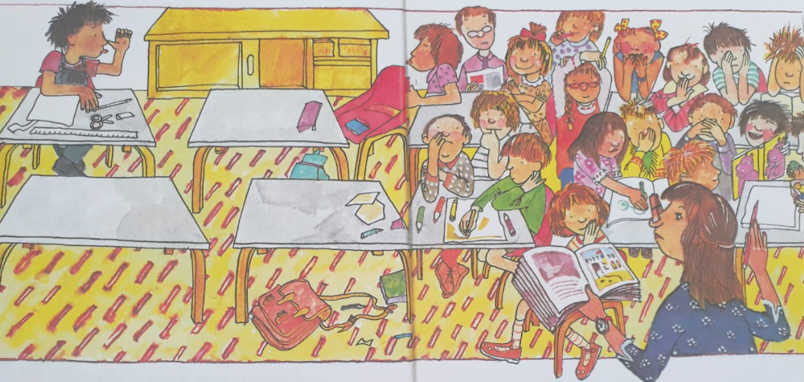
Thinking about your school, what are the things you like most about being in your class?

Slide 31
Well done everybody!!
Keep up the hard work and we will see you online again later!☺

