Slide 1
The ZONES of Regulation®

Slide 2
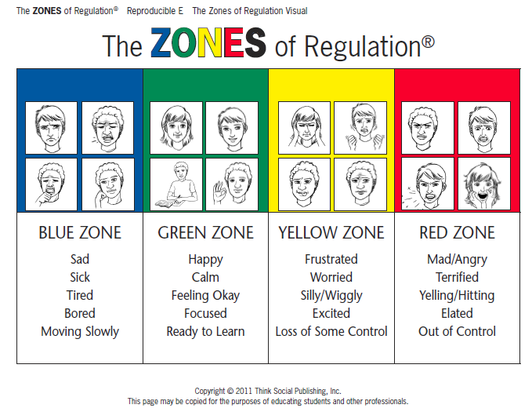

Slide 3
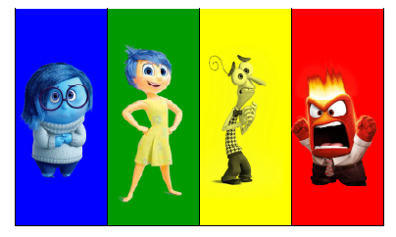
Other Tools and ZONES Visuals

Slide 4
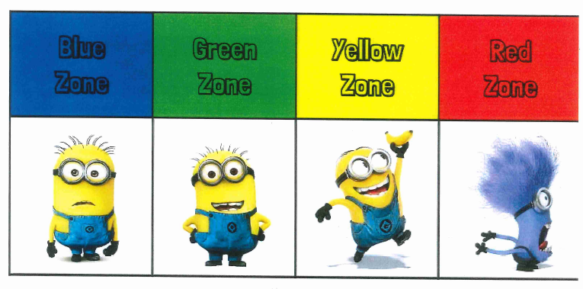
Other Tools and ZONES Visuals

Slide 5
There is no such thing as a bad ZONE.
It is important to note that everyone experiences all of the zones—the Red and Yellow Zones are not the “bad” or “naughty” zones.
All of the zones are expected at one time or another.

Slide 6
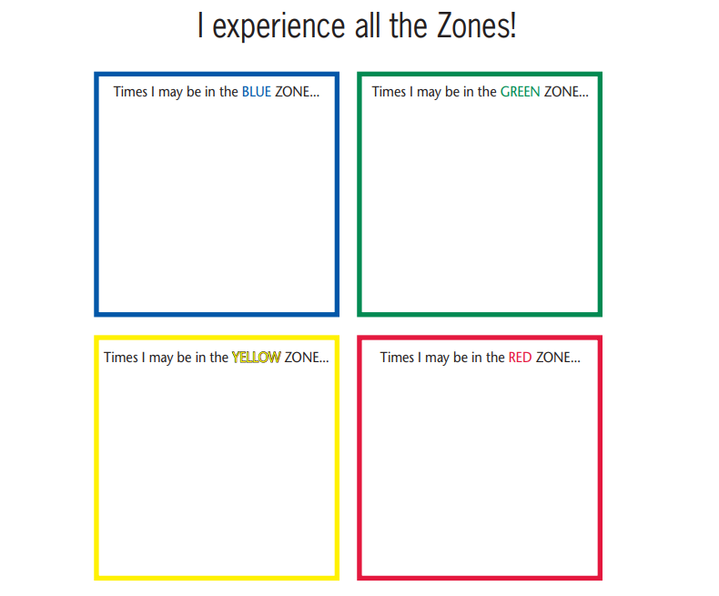

Slide 7
ZONES Lesson Plans and Videos
  Here is a video on what it looks like to be in the Blue Zone (Barbie crying and upset): http://www.youtube.com/watch?v=a5ze5PfDEzI&index=2&list=PL87B22B04EC463D3B
  Here is a video on what it looks like to be in the Green Zone: (Finding Nemo: Just Keep Swimming): https://www.youtube.com/watch?v=sB6W2VAx2J8
  Here is a video on what it looks like to be in the Yellow Zone (Mike’s New Car): https://www.youtube.com/watch?v=zfC_GuHiP68
  Here is a video on what it looks like to be in the Red Zone (Lucy mad in Charlie Brown): http://www.youtube.com/watch?v=pq9hBEvFNlM&list=PLD7C6A74DFECE6B3F&index=1

Slide 8
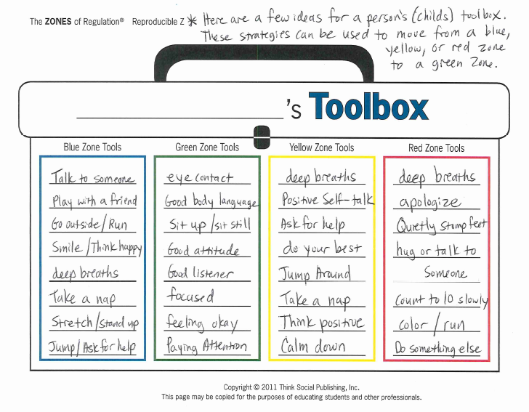

Slide 9
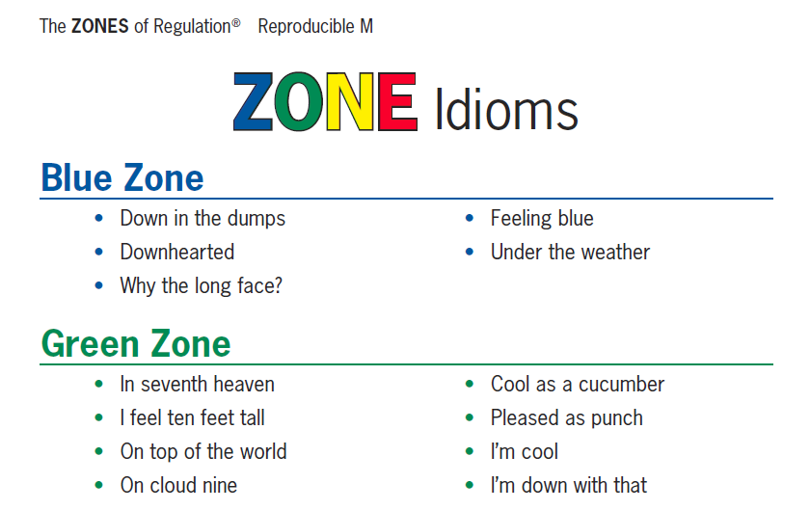
Other Tools and ZONES Visuals

Slide 10
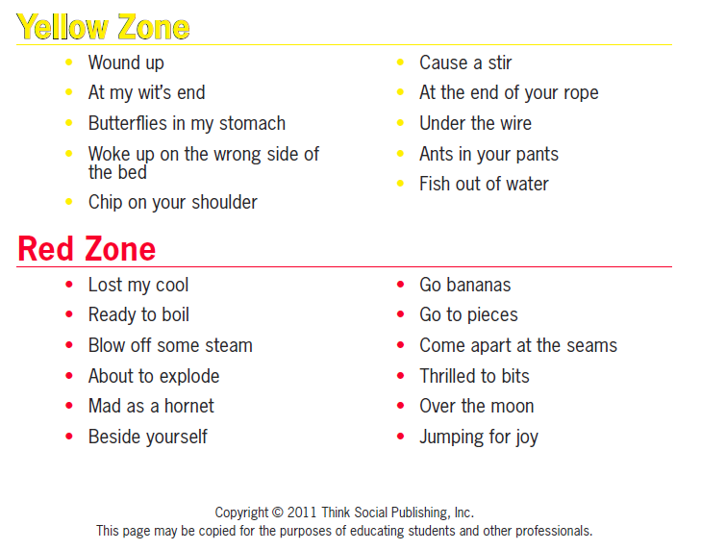
Other Tools and ZONES Visuals

