Slide 2
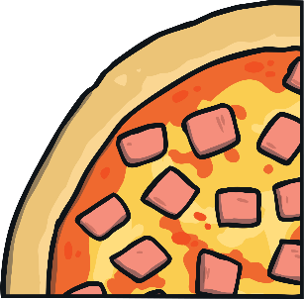
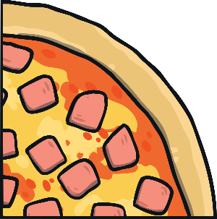
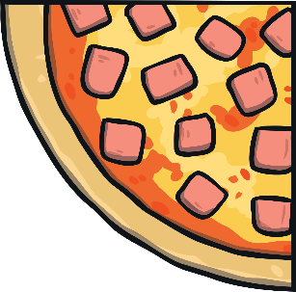
Proper Fractions
The numerator
This shows us the number of pieces we have.
3
4
The denominator
This shows us the number of parts we are dividing by.
A proper fraction is where the numerator is less than the denominator.

Slide 3

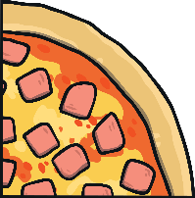
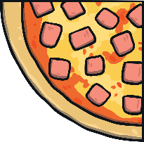
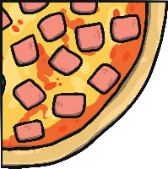
Improper Fractions
The numerator
This shows us the number of pieces we have.
7
4
The denominator
This shows us the number of parts we are dividing by.
An improper fraction is where the numerator is greater than or equal to the denominator.
This happens because you have a whole or more than a whole.

Slide 4
Improper Fractions to Mixed Numbers
You can convert an improper fraction into a mixed number.
Divide the numerator (7) by the denominator (4).
7 ÷ 4 = 1 r3
7
4
1 r3 written as a mixed number is v
1
3
4

Slide 5


Improper Fractions to Mixed Numbers
11
14
8
10
9
5
6
4

Slide 6
Improper Fractions to Mixed Numbers Answers
11
1
1
14
=
1
5
=
10
10
9
9
8
=
1
3
5
5
1
1
6
=
2
or
1
4
4
2

Slide 7
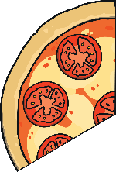
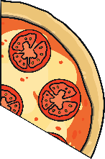

Mixed Numbers to Improper Fractions
You can also convert a mixed number into an improper fraction.
First you need to multiply the whole number by the denominator.
2
1
3
2 × 3 = 6
Then add the total to the numerator. 6 + 1 = 7
Then write the answer over the denominator.
7
3

Slide 8

Mixed Numbers to Improper Fractions
Convert these mixed numbers into improper fractions:
1
3
3
2
4
5
5
4
7

Slide 9
Mixed Numbers to Improper Fractions Answers
1
3
3
=
7
2
=
17
4
4
5
5
5
4
=
39
7
7

