Slide 2
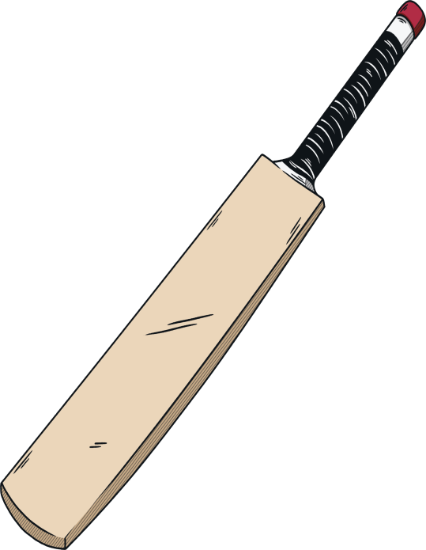
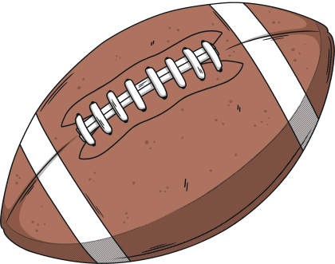
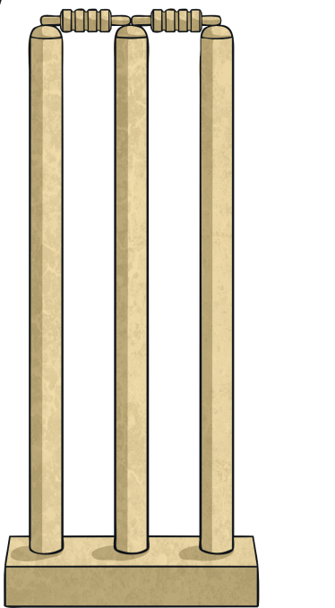



What Am I?
Use the clues to guess the sport being described.

Slide 3




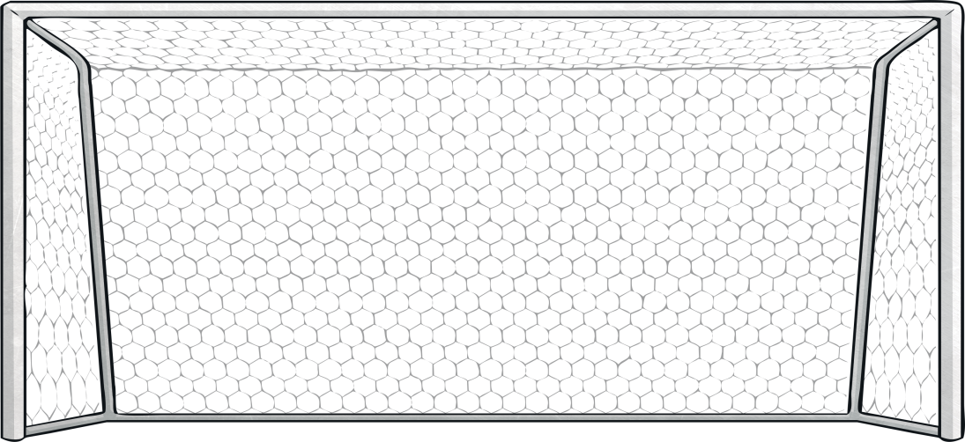
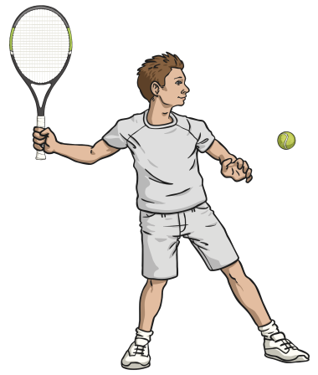
Click the whistles to reveal the clues.
Players use rackets and a ball.
I am played on a court with a low net across the middle.
One of my most famous tournaments is played at Wimbledon each year.
tennis
What Am I?
Next

Slide 4
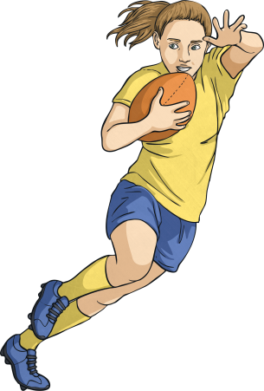
Click the whistles to reveal the clues.
Players can score tries or make conversions.
I am played with an oval shaped ball.
Players must pass the ball backwards.
rugby
What Am I?
Next

Slide 5
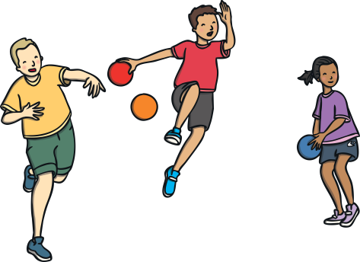
Click the whistles to reveal the clues.
I am played by two teams with 6 players each.
More than one ball is used at a time.
Players aim to eliminate members of the opposite team with a ball.
What Am I?
dodgeball
Next

Slide 6
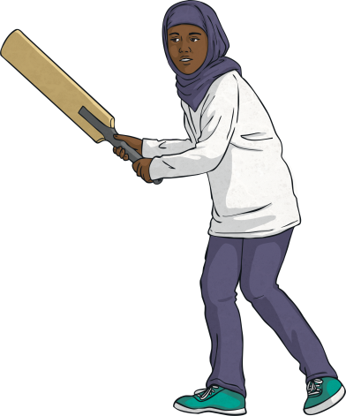
Click the whistles to reveal the clues.
I am played with a bat and a hard ball.
Players can score points by making runs.
One player is a wicket keeper.
What Am I?
cricket
Next

Slide 7
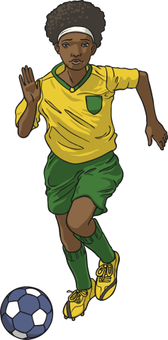
Click the whistles to reveal the clues.
There are two nets, one at either end of the pitch.
Players move the ball with their feet.
I am sometimes called the ‘beautiful game’.
What Am I?
football
Next

Slide 8
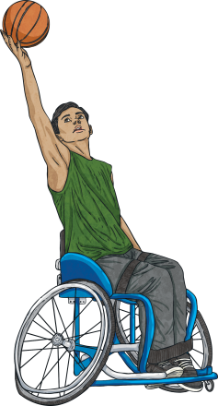
Click the whistles to reveal the clues.
I am played on a court by two teams of 5 players.
Players score points by shooting the ball through a hoop.
Players can make a slam dunk by pushing the ball through a hoop.
What Am I?
basketball
Next

Slide 9
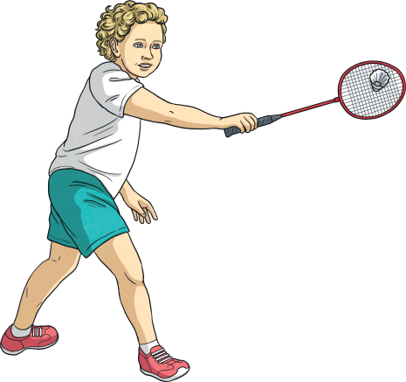
Click the whistles to reveal the clues.
I am played on an indoor court with a net across
the middle.
Players use rackets with long thin handles.
Players hit a shuttlecock.
What Am I?
badminton
Next

Slide 10
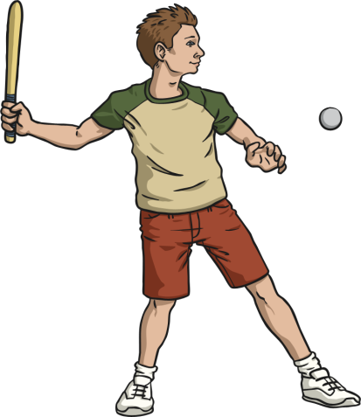
Click the whistles to reveal the clues.
A team is made up of nine players.
Teams take it in turns to field or bat.
Players must run around four bases. A player is safe when they have stopped at a base.
What Am I?
rounders
Next

Slide 11
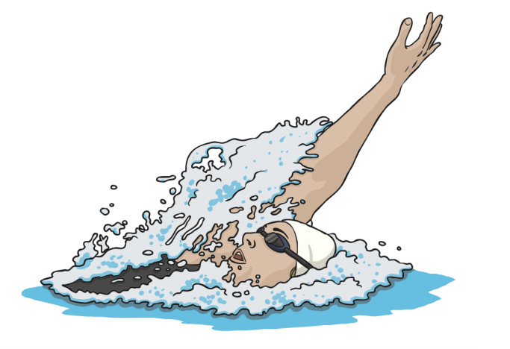
Click the whistles to reveal the clues.
Participants stay in lines known as lanes.
Participants travel using different strokes.
Be prepared to get wet.
What Am I?
swimming
Next

Slide 12
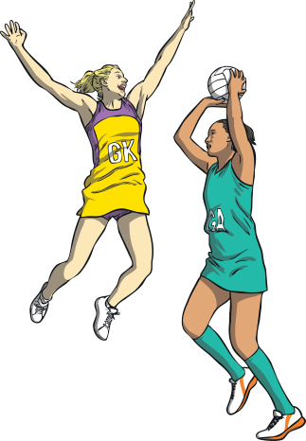
Click the whistles to reveal the clues.
I am played by two teams with seven players each.
I am mostly played by women.
There is no running with the ball or dribbling
the ball.
What Am I?
netball
Next

Slide 13
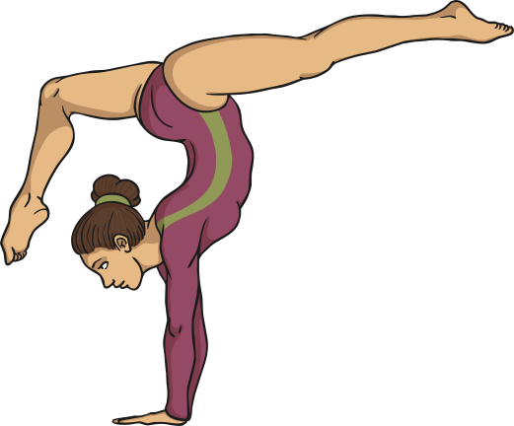
Click the whistles to reveal the clues.
I require flexibility and coordination.
Equipment could include a horse, bars or rings.
Some of the movements needed include rolls, springs and cartwheels.
What Am I?
gymnastics
Next

