Slide 1



LIFE/work balance
We have started a #LIFEworkbalance campaign and we need your help to complete our LIFE/work balance survey.
We hope to publish the results soon, so please give 15 minutes of your time to help us get a true picture of school life.
Want to be a part of this campaign? Take the survey on our website and share it with your colleagues!
© Classroom Secrets Limited 2019

Slide 2
Year 5 – Spring Block 3 – Decimals and Percentages – Understand Percentages
About This Resource:
This PowerPoint has been designed to support your teaching of this small step. It includes a starter activity and an example of each question from the Varied Fluency and Reasoning and Problem Solving resources also provided in this pack. You can choose to work through all examples provided or a selection of them depending on the needs of your class.
National Curriculum Objectives:
Mathematics Year 5: (5F11) Recognise the per cent symbol (%) and understand that per cent relates to ‘number of parts per hundred’, and write percentages as a fraction with denominator 100, and as a decimal
More Year 5 Decimals and Percentages resources.
Did you like this resource? Don’t forget to review it on our website.
© Classroom Secrets Limited 2019

Slide 3
Year 5 – Spring Block 3 – Decimals and Percentages
Step 8: Understand Percentages
© Classroom Secrets Limited 2019

Slide 4
Introduction
Circle the fraction and decimal which match the picture.
70
100
0.34
0.75
3
4
30
100
0.7
© Classroom Secrets Limited 2019

Slide 5
Introduction
Circle the fraction and decimal which match the picture.
70
100
0.34
0.75
3
4
30
100
0.7
© Classroom Secrets Limited 2019

Slide 6
Varied Fluency 1
Match the grids to their percentages.
A
78%
B
60%
80%
C
© Classroom Secrets Limited 2019

Slide 7
Varied Fluency 1
Match the grids to their percentages.
A
78%
B
60%
80%
C
© Classroom Secrets Limited 2019

Slide 8
Varied Fluency 2
Write the percentage represented by the grids below.
A
B
© Classroom Secrets Limited 2019

Slide 9
Varied Fluency 2
Write the percentage represented by the grids below.
A
B
90%
63%
© Classroom Secrets Limited 2019

Slide 10
Varied Fluency 3
Represent 40% on the grids below.
A
B
© Classroom Secrets Limited 2019

Slide 11
Varied Fluency 3
Represent 40% on the grids below.
Various possible answers, for example:
A
B
© Classroom Secrets Limited 2019

Slide 12
Reasoning 1
Circle the odd one out.
Explain your reasoning.
A
B
C
D 45%
© Classroom Secrets Limited 2019

Slide 13
Reasoning 1
Circle the odd one out.
Explain your reasoning.
C is the odd one out because…
A
B
C
D 45%
© Classroom Secrets Limited 2019

Slide 14
Reasoning 1
Circle the odd one out.
Explain your reasoning.
C is the odd one out because it represents 50%.
A, B and D represent 45%.
A
B
C
D 45%
© Classroom Secrets Limited 2019

Slide 15
Problem Solving 1
Put the cards in order from largest to smallest.
53 parts per 100
35%
4 parts out of 10
61%
7 parts per 10
16 parts out of 100
© Classroom Secrets Limited 2019

Slide 16
Problem Solving 1
Put the cards in order from largest to smallest.
7 parts per 10
61%
53 parts per 100
4 parts out of 10
35%
16 parts out of 100
© Classroom Secrets Limited 2019

Slide 17
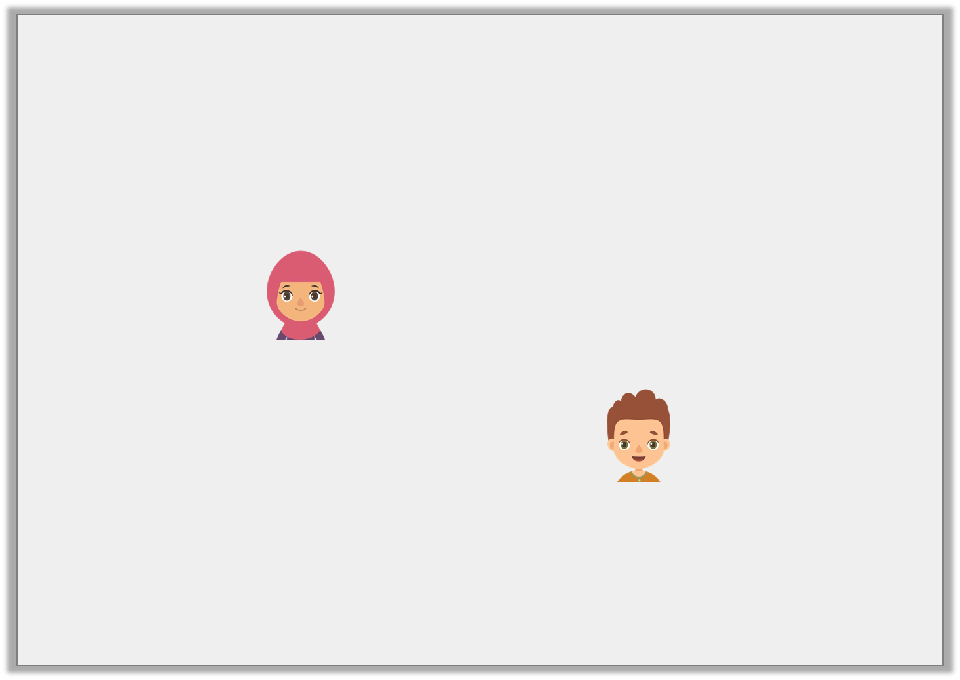
Reasoning 2
Alia and Ben are shown a bar model.
Alia says,
Ben says,
Who is correct? Convince me.
9% is shaded
90% is shaded
© Classroom Secrets Limited 2019

Slide 18
Reasoning 2
Alia and Ben are shown a bar model.
Alia says,
Ben says,
Who is correct? Convince me.
Ben is correct because…
9% is shaded
90% is shaded
© Classroom Secrets Limited 2019

Slide 19
Reasoning 2
Alia and Ben are shown a bar model.
Alia says,
Ben says,
Who is correct? Convince me.
Ben is correct because the bar model is split into 10 parts. Percentages are the number of parts out of 100 so
9 needs to be multiplied by 10 to find the percentage.
9% is shaded
90% is shaded
© Classroom Secrets Limited 2019

