Slide 1
PSHE and Citizenship
Health and Wellbeing | Aspirations, Dreams and Goals
PSHE and Citizenship | KS1 | Health and Wellbeing | Aspirations, Dreams and Goals

Slide 3
Aim
I can set simple but challenging personal goals.
Success Criteria
I can identify some things I have already achieved in life.
I can identify things I’d like to achieve in the future.
I can consider what I will need to do to achieve my goal.
This resource is fully in line with the Learning Outcomes and Core Themes outlined in the PSHE Association’s Programme of Study.

Slide 4
The Big Questions

Slide 5

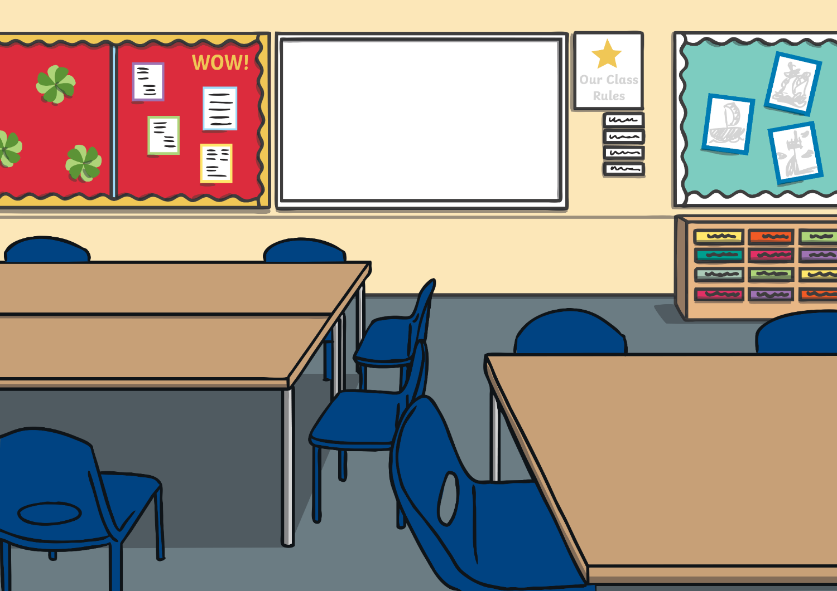

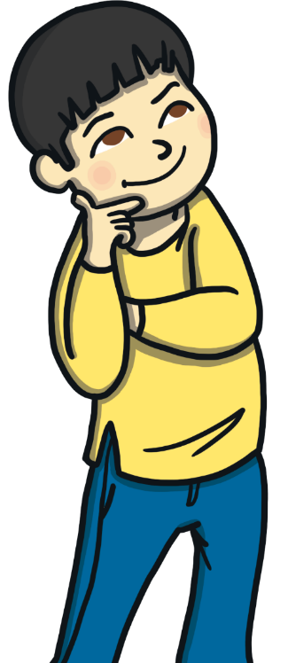
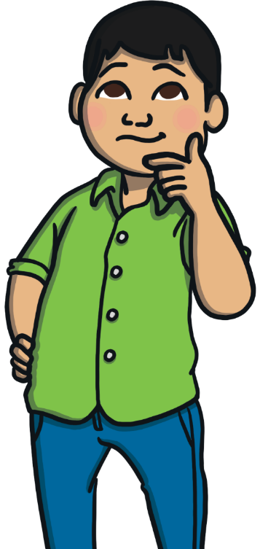
The Big Questions
What have we already learnt to do in our lives and what have we already achieved?
How can we learn new things and achieve our dreams and goals?

Slide 6
Reconnecting

Slide 7

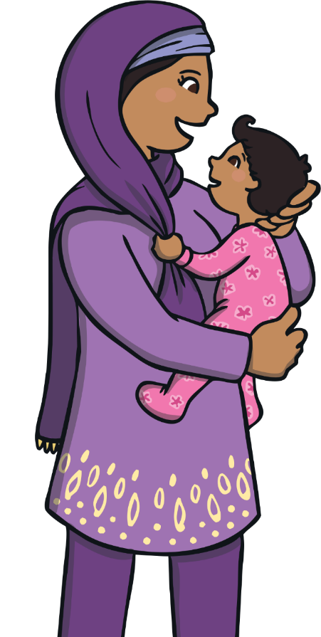
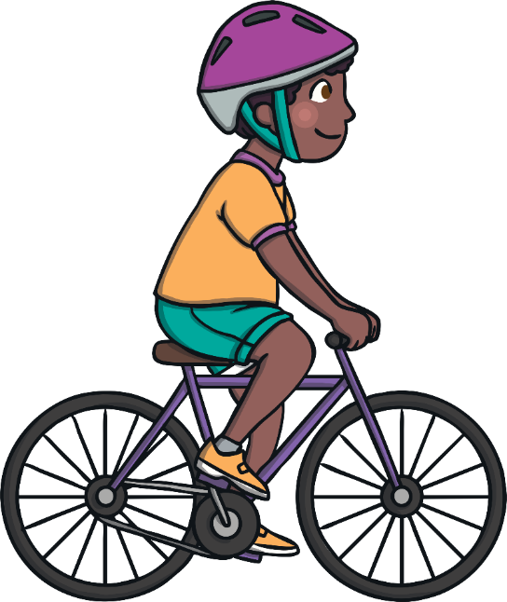
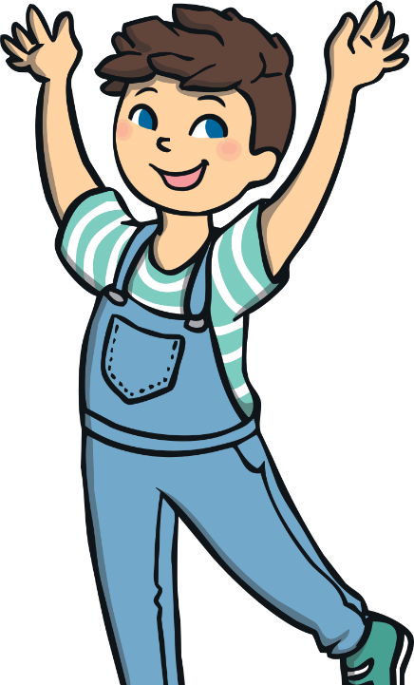
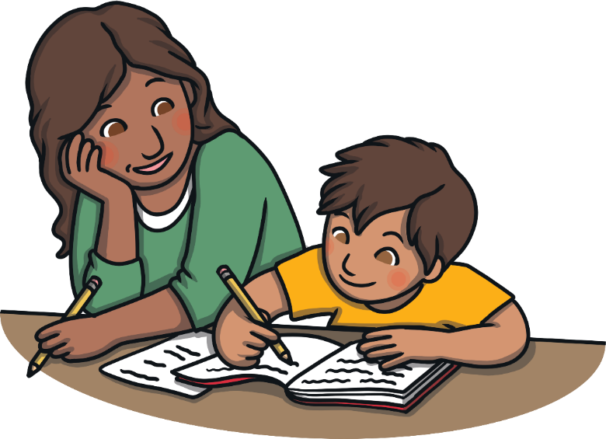
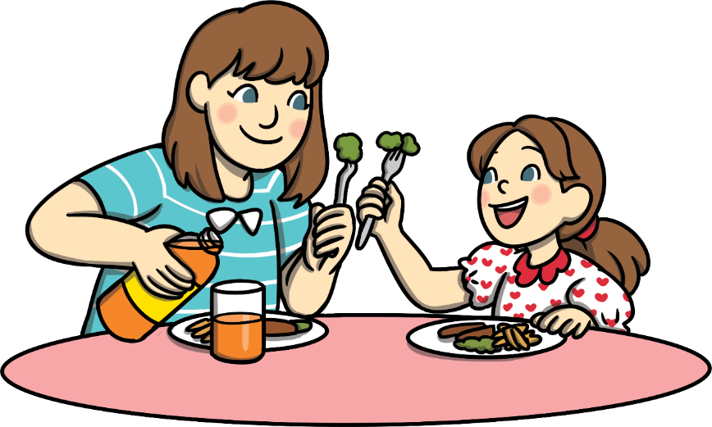
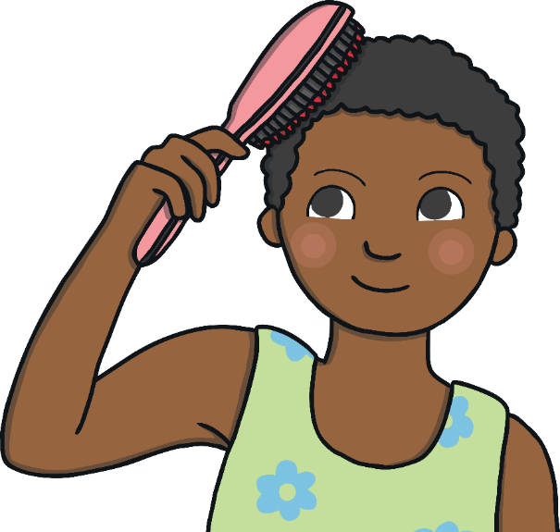
We Are All Achievers!
Maybe you’ve learnt how to ride a bike,
You know your own mind and you know what you like.
You can probably run and jump and dance,
And sing your favourite song, whenever you get the chance!
No, babies can’t do much, but you’ve achieved a lot,
Think what you’ve learnt since you were a tot!
You can say how you feel, brush your hair,
Write your name, choose what to wear.
When you were a baby, you could do so little –
Just eat and sleep, babble and giggle.
Now you are older, you can do so much more –
Feed yourself and open the door.

Slide 8

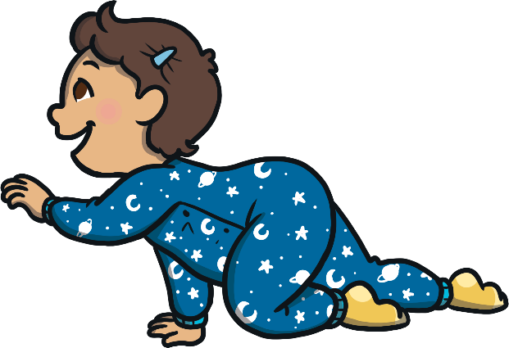
We Are All Achievers!
That’s right! We may not stop to think about it very often but we have all achieved a lot since we were first born. As babies, we could hardly do anything ourselves but as we grew, we learnt so many new skills.
Chat with your partner and see if you can think of five things that you have both learnt to do since you were babies.

Slide 9
Exploring

Slide 10

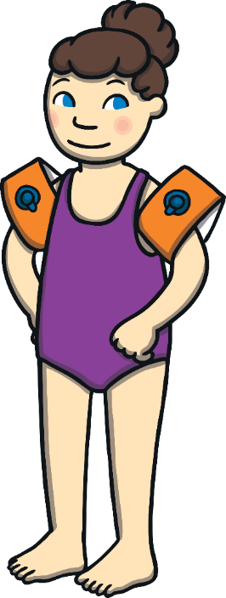
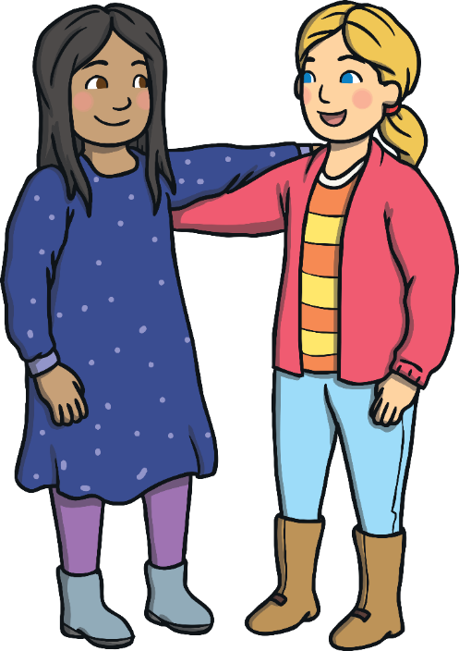
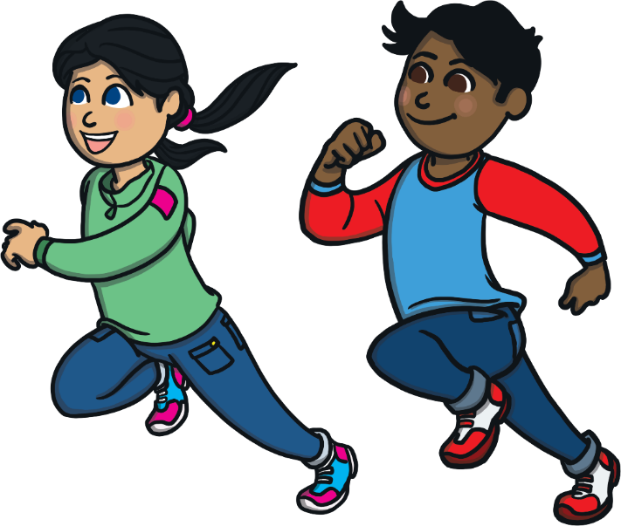
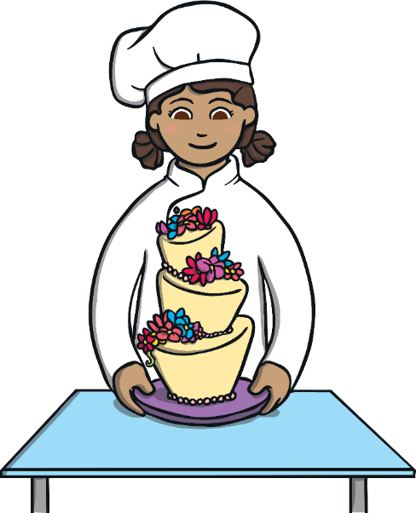
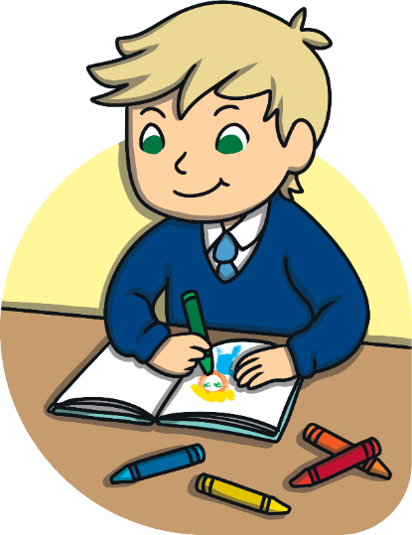
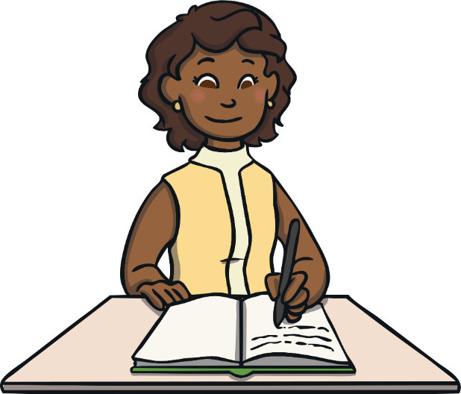
Different Dreams
All people are different - we are interested in different things, enjoy doing different things and are good at different things.
This means that people have different dreams and goals.
What one person finds easy, another person might find tricky.
Some people want to get faster at running.
Some people want to learn how to bake a cake.
Some people want to improve their handwriting.
Some people want to learn how to swim.
Some people want to get better at drawing.
And some people want to be a better friend.

Slide 11
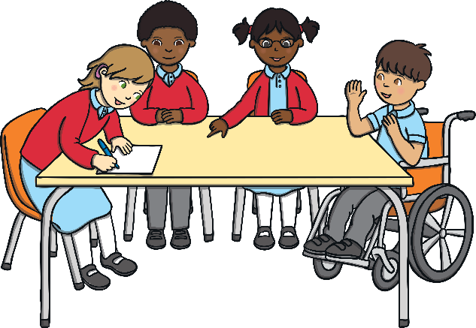
Different Dreams
It’s great that we are all different and that we all have different dreams and goals.
Let’s work in groups to share our dreams and goals with each other.
If someone in your group
says that they want to learn
to do something that you
can already do, smile and encourage them – don’t make fun of them because they can’t do it yet.
You could even give them some advice about how you learnt to do that
particular thing.
Remember to listen carefully to each other and show respect.

Slide 12

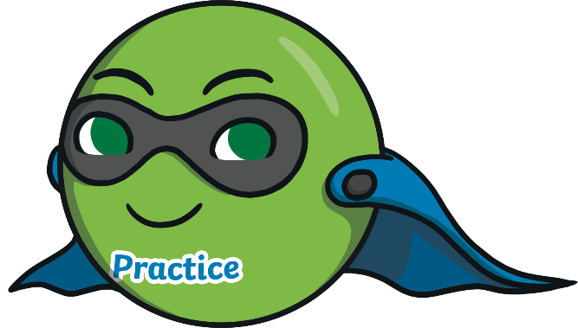
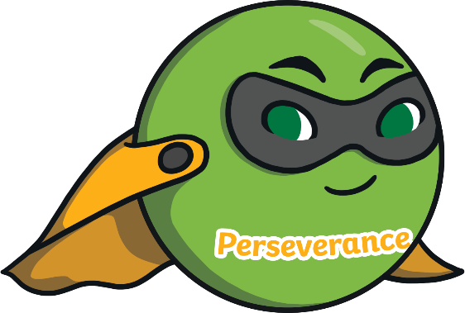
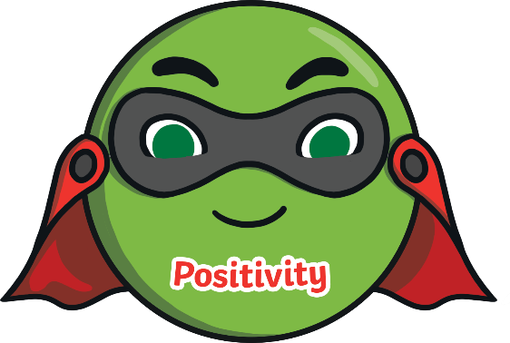
The Three Ps
Meet The Three Ps! (or should that be The Three Peas?)
Meet Practice Pea!
Practice Pea knows that to learn new skills and achieve our goals, we have to put time and effort in and practise. That’s how we get better and more confident at things we might find tricky at first.
Perseverance Pea knows that you have to stick at it when you are trying to get better at something or learn something new. If we stop trying when we make a mistake or when things get a little tough, we’ll never improve. Perseverance is all about not giving up.
Meet Perseverance Pea!
Positivity Pea knows that a positive attitude is very important when it comes to achieving our dreams and goals. We have to believe in ourselves and believe we can do it. We can also feel proud of ourselves when we get better at something or we do something well.
Meet Positivity Pea!

Slide 13
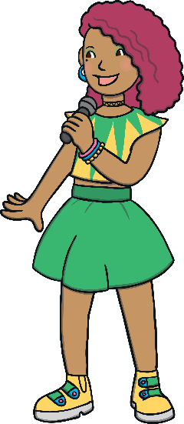
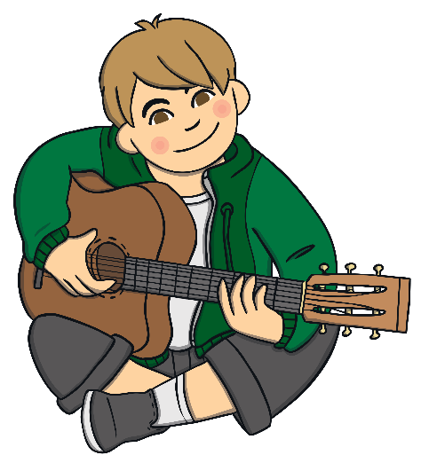
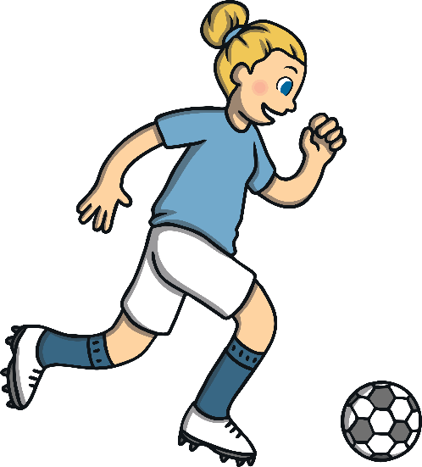

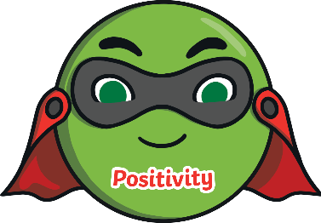

The Three Ps
Practice, positivity and perseverance are all really important when it comes to working towards a dream or goal. Without them, we wouldn’t get very far.
Imagine trying to get better at playing football without ever practising!
Imagine trying to sing on the stage if you kept telling yourself you couldn’t do it!
Imagine trying to learn to play the guitar if you gave up the first time you plucked the wrong string!
Thank goodness for those superheroes, The Three Peas!

Slide 14
Consolidating
Reflecting

Slide 15
Consolidating

Slide 16

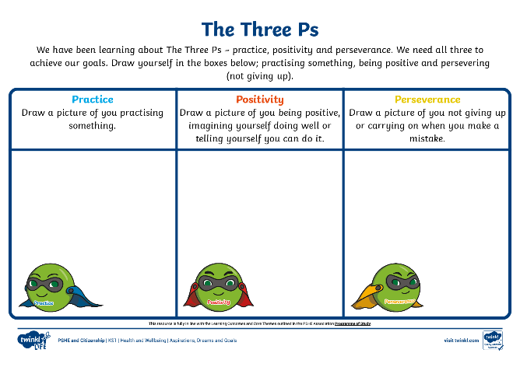
We All Need the Three Ps!
The three Ps, practice, positivity and perseverance, are important for all of us, whatever it is we are trying to get better at or learn how to do.
On your The Three Ps Activity Sheet, you are going to draw three pictures:
You practising something.
You being positive..
You persevering (not giving up).

Slide 17
Reflecting

Slide 18

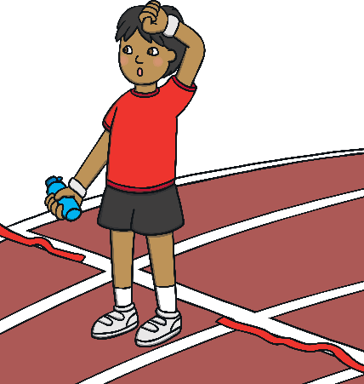
If You Want to Succeed…
How do you think you could finish this sentence?
If you want to succeed…
Discuss with your partner a good way to finish the sentence, giving advice to others about what they need to do in order to achieve their goals.

Slide 19
If You Want to Succeed…
Let’s share some of your suggestions.
If you want to succeed…

Slide 20
The Big Questions

Slide 21
The Big Questions
What have we already learnt to do in our lives and what have we already achieved?
How can we learn new things and achieve our dreams and goals?
Do you think The Three Peas might be able to help you achieve your dreams and goals in the future?

Slide 22
Aim
I can set simple but challenging personal goals.
Success Criteria
I can identify some things I have already achieved in life.
I can identify things I’d like to achieve in the future.
I can consider what I will need to do to achieve my goal.
This resource is fully in line with the Learning Outcomes and Core Themes outlined in the PSHE Association’s Programme of Study.

