Slide 1


Year 5 – Spring Block 3 – Decimals and Percentages
Step 2: Decimals as Fractions 1
© Classroom Secrets Limited 2019

Slide 2
Introduction
Match the statements to the decimals.
7 ones, 4 tenths and 5 hundredths |  | 5.47
5 ones, 7 tenths and 4 hundredths |  | 4.75
4 ones, 7 tenths and 5 hundredths |  | 7.45
5 ones, 4 tenths and 7 hundredths |  | 5.74
© Classroom Secrets Limited 2019

Slide 3
Introduction
Match the statements to the decimals.
7 ones, 4 tenths and 5 hundredths |  | 5.47
5 ones, 7 tenths and 4 hundredths |  | 4.75
4 ones, 7 tenths and 5 hundredths |  | 7.45
5 ones, 4 tenths and 7 hundredths |  | 5.74
© Classroom Secrets Limited 2019

Slide 4
Varied Fluency 1
Circle the fraction and decimal which match the picture.
9
100
90
100
0.9
0.09
© Classroom Secrets Limited 2019

Slide 5
Varied Fluency 1
Circle the fraction and decimal which match the picture.
9
100
90
100
0.9
0.09
© Classroom Secrets Limited 2019

Slide 6
Varied Fluency 2
Match the fractions to their decimal equivalents.
A. | 6 |  | 0.6
 | 100
B. | 6 |  | 0.65
 | 10
C. | 65 |  | 0.06
 | 100
© Classroom Secrets Limited 2019

Slide 7
Varied Fluency 2
Match the fractions to their decimal equivalents.
A. | 6 |  | 0.6
 | 100
B. | 6 |  | 0.65
 | 10
C. | 65 |  | 0.06
 | 100
© Classroom Secrets Limited 2019

Slide 8
Varied Fluency 3
Complete the table below.
Fractions | Decimals
 | 0.07
25
100
1
2
© Classroom Secrets Limited 2019

Slide 9
Varied Fluency 3
Complete the table below.
Fractions | Decimals
 | 0.25
 | 0.07
 | 0.5
25
100
7
100
1
2
© Classroom Secrets Limited 2019

Slide 10
Varied Fluency 4
True or false?
3 | = | 3.4
4
© Classroom Secrets Limited 2019

Slide 11
Varied Fluency 4
True or false?
False:
3 | = | 3.4
4
3 | = | 0.75
4
© Classroom Secrets Limited 2019

Slide 12
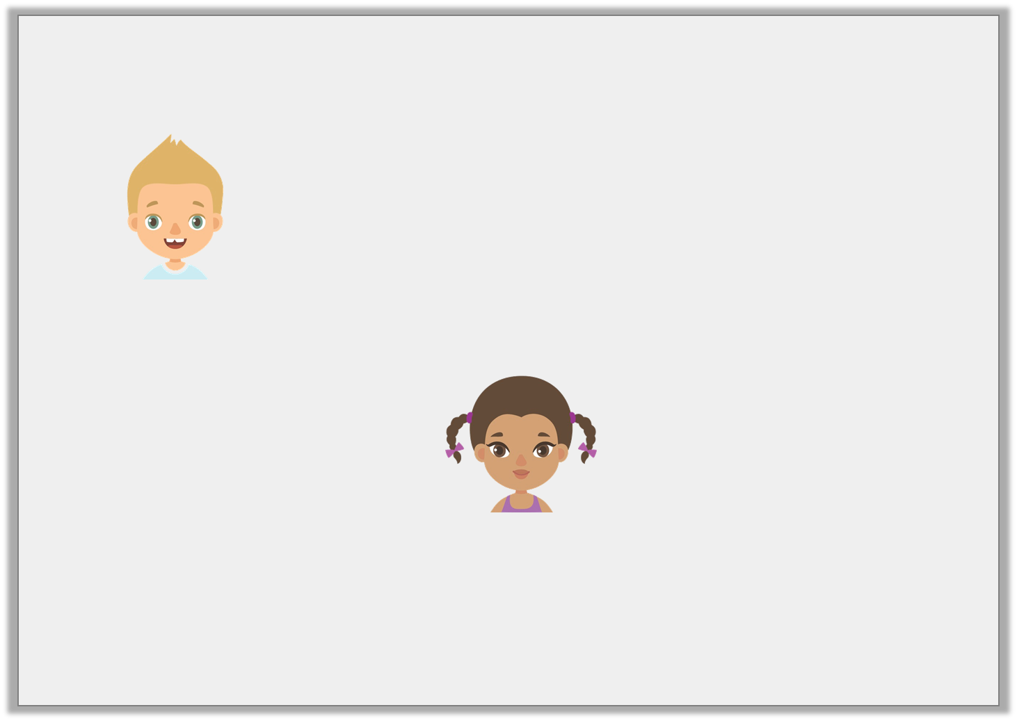
Reasoning 1
Seth says,
Leticia says,
Who is correct? Prove it.
is equal to 0.25
1
4
is equal to 1.4
1
4
© Classroom Secrets Limited 2019

Slide 13
Reasoning 1
Seth says,
Leticia says,
Who is correct? Prove it.
Seth is correct because…
is equal to 0.25
1
4
is equal to 1.4
1
4
© Classroom Secrets Limited 2019

Slide 14
Reasoning 1
Seth says,
Leticia says,
Who is correct? Prove it.
Seth is correct because is equal to which is equal to 0.25.
is equal to 0.25
1
4
is equal to 1.4
1
4
1
4
25
100
© Classroom Secrets Limited 2019

