Slide 1
Thursday 21st October 2021
LO: To write Scene 3.

Slide 2
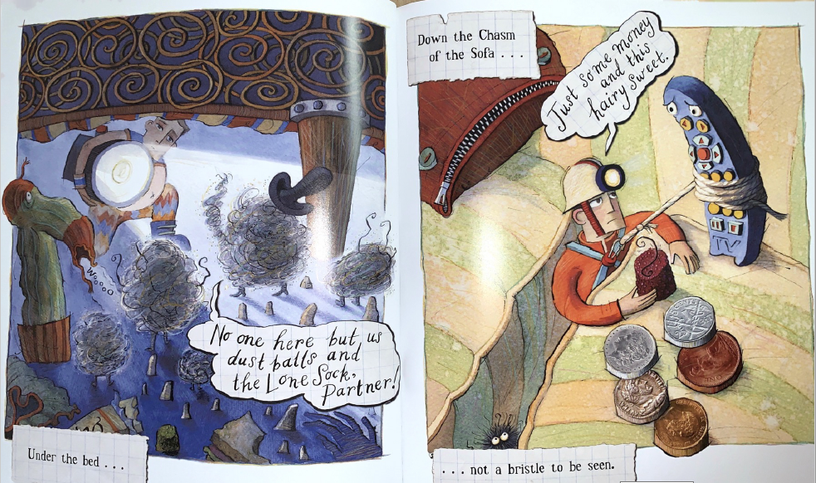
3. Sofa (under and on)

Slide 3
When writing today…
Start a new line for a new character.

Slide 4
Set the scene
New line
Where is this scene taking place?
What is happening in this scene?
Sheet example
Teacher- model a sentence

Slide 5

Stage directions
Where are the characters when starting the scene?
Sheet example
Teacher- model a sentence

Slide 6
Traction Man: (____________) ____________________________________
____________________________________
Speech and character directions.
Add in Traction Man’s directions.
What is he saying to the other characters?

Slide 7
Dust balls and sock: (____________) ____________________________________
____________________________________
Speech and character directions.
Add in the dust balls and sock’s directions.
What is he saying back to Traction Man?

Slide 8
Traction Man: (____________) I’ll try looking down here for Turbo Dog! ________________________________
____________________________________
Speech and character directions.
Add in Traction Man’s directions.
Think about- What is he doing with the rope round him?
What is he saying to the other character?

Slide 9
Remote: I’ll hold you up. (wait a moment and lean back to pull up rope) Find anything Traction Man?_____________
____________________________________
Speech and character directions.
Add in Remote’s directions and speech.
Use the model to help.

Slide 10
Traction Man: (____________) ________________________________
____________________________________
Speech and character directions.
Add in Traction Man’s directions.
What is Traction Man going to say in response to Remote?

