Slide 1
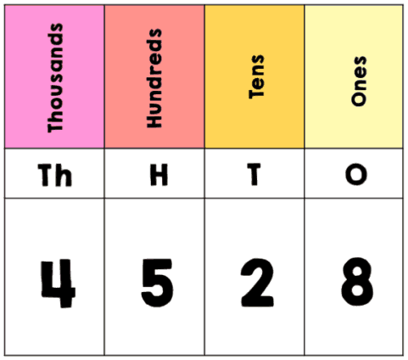
Year 4 - Maths
Number and Place Value

Slide 2
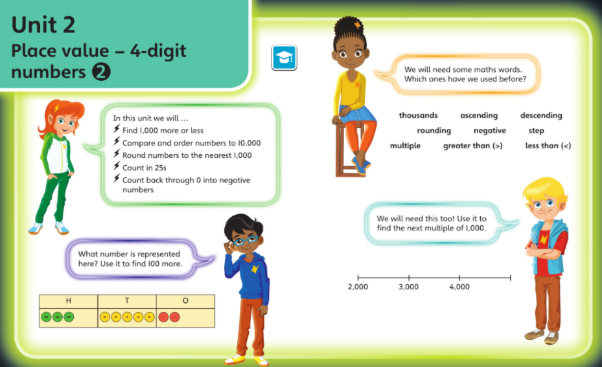

Slide 3
THURSDAY

Slide 4
Number and Place Value – End of Unit Check
21.10.21
LO: To demonstrate my understanding of place value

Slide 5
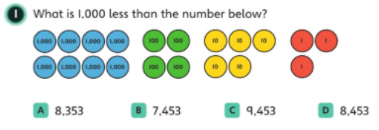

Slide 6
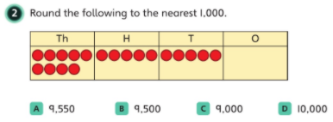

Slide 7
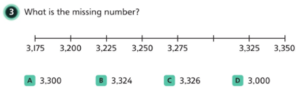

Slide 8
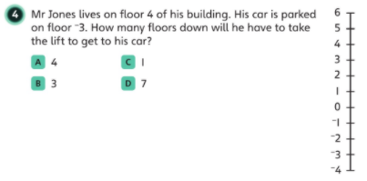

Slide 9
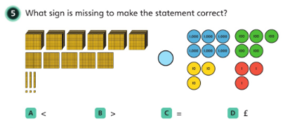

Slide 10


