Slide 1
Wednesday 20th October 2021
LO: To write Scene 1 and 2 of a playscript

Slide 2
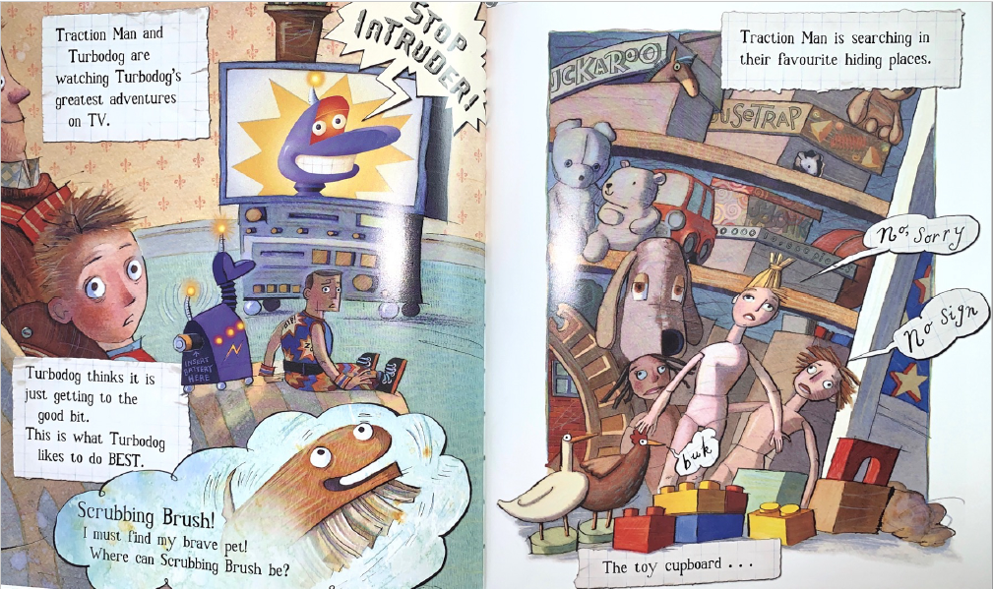
1. Living room.
2. Toy cupboard.

Slide 3
When writing today…
Start a new line for a new character.

Slide 4
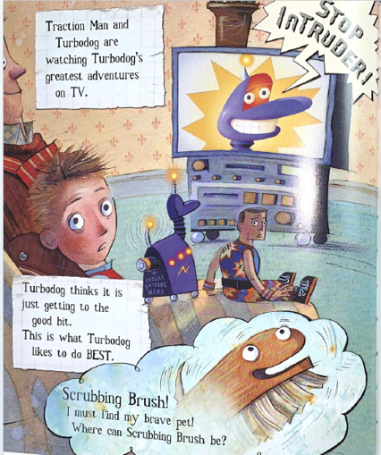
Set the scene
New line
Where are the characters?
What are they doing?
Sheet example
Teacher- model a sentence

Slide 5

Stage directions
Where are the characters when starting the scene?
Sheet example
Teacher- model a sentence

Slide 6
What do they hear?
Discuss.
Who is talking in this page?

Slide 7
Turbo Dog: (happy and ____________) ____________________________________
____________________________________
Speech and character directions.
Add in Turbo Dogs directions.
Could he be saying something to himself also?

Slide 8
Traction Man: (looking _________ and thinking out loud) ___________________
____________________________________
Speech and character directions.
Add in Traction Mans directions and speech.

Slide 9
Traction Man: (Getting up and ____________ ) _____________________
____________________________________
Speech and character directions.
Add in Traction Mans directions and speech.
What is he going to do now?
What might he say?
Teacher- model a sentence

Slide 10
Discuss
Why do you think we are we starting a new scene now?

Slide 11
Set the scene
Who is going to the cupboard?
What are the characters doing in the toy cupboard?
Sheet example
Teacher- model a sentence

Slide 12
Stage directions
Where are the characters when starting the scene?
Sheet example
Teacher- model a sentence

Slide 13
Traction Man: (_____________________) ____________________________________
____________________________________
Speech and character directions.
Add in Traction Mans directions and speech.
What is Traction man doing?
What question is he asking?

Slide 14
Girl doll: (_____________________) ____________________________________
____________________________________
Boy doll: (_____________________) ____________________________________
____________________________________
Speech and character directions.
Add in the dolls directions and speech.
What actions might these chacacters be doing, whilst talking?

