Slide 1
Friday 22st October 2021
LO: Write Scene 4

Slide 2
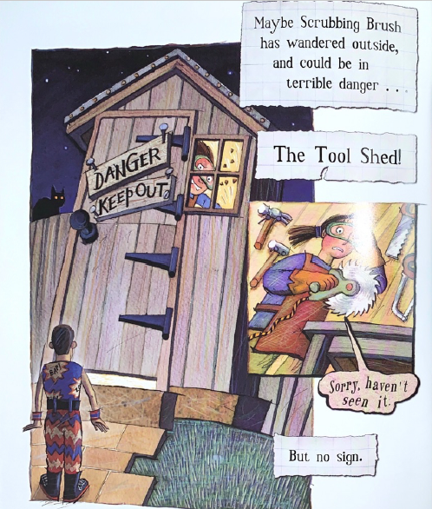
4. Shed

Slide 3
When writing today…
Start a new line for a new character.
Think about directions before and after the character speaks.

Slide 4
Set the scene
New line
Where is this scene taking place?
What is happening in this scene?
Sheet example
Teacher- model a sentence

Slide 5

Stage directions
Where are the characters when starting the scene?
Sheet example
Teacher- model a sentence

Slide 6
Traction Man: (____________) ____________________________________
____________________________________
(walks towards ____, ____shed and opens the door) _____________________
____________________________________
Speech and character directions.
Add in Traction Man’s directions.
What is he thinking to himself out loud before he enters the shed?

Slide 7
Lady: (____________) ____________________________________
____________________________________
Speech and character directions.
Add in the Lady’s directions and response to Traction Man.

Slide 8
Traction Man: (____________) ____________________________________
____________________________________
(Walking away to continue his search_____________________________)
Speech and character directions.
Add in Traction Man’s directions and response to Lady.

